Slide 1
Summary of EMPLOYEE Health Benefits
JBI, LTD
Effective September 1, 2024

Slide 2
Health Plan Annual Open Enrollment
Open Enrollment
Open enrollment every August
Changes can be made to health coverage selections during open enrollment
Health Benefit Resources
www.thediamondbenefitgroup.com/jbi-ltd/
Notes:
Not open enrollment for FSA - Calendar Year for FSA accounts
Deadline Monday, August 22rd

Slide 3
Annual Health Plan Open Enrollment
Effective 9/1/2024
Offer a Choice of Two Medical Plan Options
– One Gold and One Silver (no changes)
Dental Benefits (no changes)
Vision Benefits (no changes)
Survivor & Disability Benefits (no changes)
Includes Company Paid Life/AD&D & LTD
Includes EE Paid Voluntary Term Life/AD&D Insurance
Supplemental Benefits (no changes)
Includes EE Paid Accident, Cancer, Medical Bridge, & Critical Illness
Notes:
Added Dual Option Sept. 2017
Gold & Silver Metallic options
Dental, Vision, Life, Disability, Supplement – NO Changes

Slide 4
What Benefits are Offered?
Two Medical Options (includes Rx)
Blue Cross Blue Shield (BCBS)
Dental
BCBS Blue Care
Vision
Vision Service Plan (VSP)
Basic Term Life/AD&D
RSL
Long Term Disability
RSL
Voluntary Term Life
RSL
Supplemental Insurance
Colonial Life
Notes:
All carriers remain the same
Medical – GOLD & SILVER
New Gold

Slide 5
Other Services Available to You with RSL
Reliance Standard Life (RSL)
Value Added Services
24-hour Travel Assistance through On Call International
Identity Theft Restoration Services through InfoArmor
Bereavement Support Services through ACI Specialty Benefits
Notes:
Provided through RSL

Slide 6
Your Supplemental Insurance Benefits
Cancer
Accident
Medical Bridge
Critical Illness
Notes:
Colonial Life – Supplemental benefits

Slide 7
COBRA Monthly Rates for Health Coverage (Medical/Dental/Vision) Effective 9/1/2024
Silver Option
EE Only $920.94
EE & SP $1,838.15
EE & CH $1,858.87
FAM $2,802.48
Gold Option
EE Only $1,044.80
EE & SP $2,085.87
EE & CH $2,106.59
FAM $3,174.06
Notes:
Medical/Dental/Vision Rates plus 2%
Package (M/D/V)

Slide 8
What is your Federal Income Tax (FIT) Tax Bracket
2025 Tax Brackets and Rates
Rate | For Single Individuals, Taxable Income Over | For Married Individuals Filing Joint Returns, Taxable Income Over | For Heads of Households, Taxable Income Over
10% | Up to $11,925 | Up to $23,850 | Up to $17,000
12% | $11,925 to $48,475 | $23,850 to $96,950 | $17,000 to $64,850
22% | $48,475 to $103,350 | $96,950 to $206,700 | $64,850 to $103,350
24% | $103,350 to $197,300 | $206,700 to $394,600 | $103,350 to $197,300
32% | $197,300 to $250,525 | $394,600 to $501,050 | $197,300 to $250,500
35% | $250,525 to $626,350 | $501,050 to $751,600 | $250,500 to $626,350
37% | Over $626,350 | Over $751,600 | Over $626,350
Source: Internal Revenue Service
Federal Income Tax (FIT) Bracket plus 7.65% FICA Taxes equals your Pre-Tax Savings
12% Bracket = .1965 22% Bracket = .2965 24% Bracket = .3165 32% Bracket = .3965
The standard deduction in 2025 is $15,000 single, $30,000 married/filing joint, $22,500 head of household
Maximum earnings subject to 6.2% Social Security in 2025 is $176,100. There is no cap on 1.45% Medicare tax.
Additional .9% Medicare tax for Modified Adjusted Gross Income of more than $200,000 ($250,000 married filing jointly).
This is not tax advice. This material has been prepared for informational purposes only, and is not intended to provide tax advice. You should consult your own tax, legal, and accounting advisors for advice.

Slide 9
EE Contributions for Benefits Package
(Medical/Dental/Vision) Per Pay Period
- Paid with Pre-Tax Dollars
Employee Contributions
Per Pay Period beginning 9/1/2024
Silver Option
EE Only $62.51
EE & SP $228.52
EE & CH $232.27
FAM $403.06
Gold Option
EE Only $114.26
EE & SP $332.03
EE & CH $335.78
FAM $558.33
Notes:
Assuming 22% FIT + 7.65% - no state/local taxes = 29.65%
Gold family @ 22% bracket - $152 svg (equates $360/pp); 12 mos Tax svgs $3,944
Silver family @ 22% bracket - $99 svg (equates to $235/pp); Silver sgl $15 svg / equates $36/pp

Slide 10
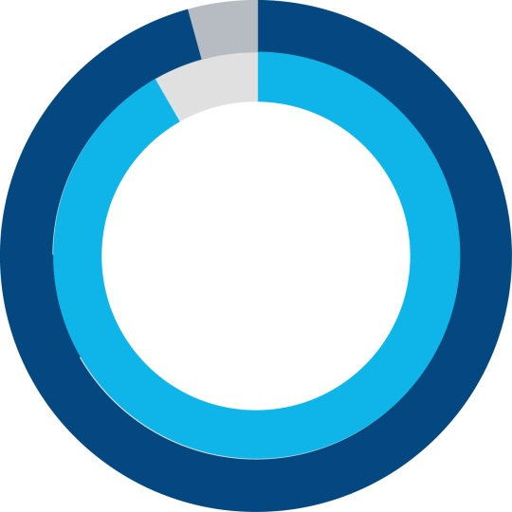




More Doctors … More Hospitals
95%
of doctors
96%
of hospitals
1.4+ million
Providers
More than 8,900
Hospitals
BCBS
Nationwide Coverage
when traveling or living outside of home state
Blue Cross Blue Shield Global® Core
coverage when traveling in
200+ countries and territories
Notes:
BlueCard program also allows members who need care when traveling to access their benefits
April 2019 Providers: 1,319,950 (315,774 PCPs/572,166 specialists/432,010 non-MD/DO)` Hospitals: 7,757 Global

Slide 11






Blue Cross and Blue Shield of Texas
More Doctors
and Hospitals
Coverage
Everywhere You Go
Personalized
Customer Service
Health and
Wellness Programs
Tools and Resources
Digital
Capabilities
Notes:
95% of doctors and 96% of hospitals nationwide
Health and Wellness programs that help you stay healthy and manage any ongoing conditions
Digital/mobile technology and programs help you access and manage your health and wellness information

Slide 12
PPO – How It Works
  Out-of-Network Providers
DISADVANTAGES
  You do have coverage, but
You pay a greater share of the costs
You may receive fewer benefits out-of-network
You may need to file your own claims
You may be billed for charges over the allowed amount (balance billing)
  In-Network Providers
ADVANTAGES
Receive the highest level of benefits and potentially pay less for care
Protection from billing over the allowed amounts (balance billing)
No claim forms (provider files claim)
No referrals required
No requirement to select a PCP
Access to a national PPO network

Slide 13
How do I find a contracting provider?
Go to Provider finder at BCBSTX.COM
Log on to your Blue Access for Members (BAM) account
Call Customer Service
(# located at back of ID card)
BCBS Global Core (Blue Card Access) available for international benefits
(800) 810-2583 www.bcbsglobalcore.com

Slide 14
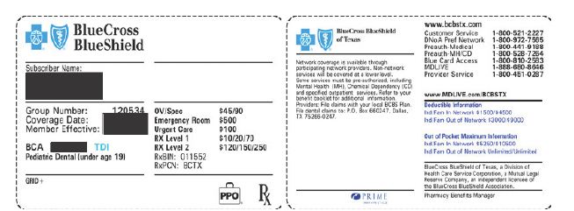
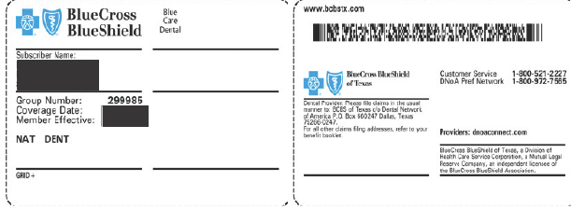
Sample Medical ID Card (front & back)
Sample Dental ID card (front & back)

Slide 15
BCBS TX Medical Comparison – #120534
Options at a Glance (Gold Versus Silver)
Benefit | Gold (G652CHC-820) |  | Silver (S665CHC-834)
 | In-Network | Out-of-Network | In-Network | Out-of-Network
Individual Deductible | $1,500 | $3,000 | $3,500 | $7,000
Family Deductible | $4,500 | $9,000 | $10,500 | $21,000
Coinsurance Percentage (after deductible) | 80% In Network 60% Out of Network |  | 60% In Network 60% Out of Network
Individual Out-of-Pocket Max | $5,250 | NA | $9,000 | NA
Family Out-of-Pocket Max | $10,500 | NA | $18,000 | NA
Office Visit / Specialist | $45 / $90 | 60%* | $50 / $90 | 60%*
Preventative Care | 100% | 60%* | 100% | 60%*
Lab-X-ray | 80%* | 60%* | 60%* | 60%*
Imaging (CT, MRI, PET Scan) | $300, No Ded | 60%* | Ded/Coins* | 60%*
Inpatient Admission | Ded/Coins* | Ded/Coins* | $250, Ded/Coins* | $350, Ded/Coins*
Outpatient Surgery | Ded/Coins* | Ded/Coins* | $200, Ded/Coins* | $300, Ded/Coins*
Emergency Room | $500, then Ded/Coins* |  | $500, then Ded/Coins*
Urgent Care | $100 | 60%* | $100 | 60%*
*Subject to deductible and coinsurance
Refer to Schedule of Coverage or Booklet for a more comprehensive summary of all benefits.
Notes:
Definitions – Deductible, Coinsurance, OOP, Copay

Slide 16
Your Medical Plan in Network
Applies to PPO Maximum Out of Pocket
PPO Deductible
PPO Coinsurance (%)
PPO Copays
PPO Copays include office visit, specialist, Rx, urgent care, hospital inpatient, outpatient surgery, & ER
Copays do NOT apply to the Deductible
Once PPO Out-of-Pocket Maximum is met, eligible claims will be covered at 100% for rest of calendar year
Notes:
Deductible, Coinsurance, Copay, Max. OOP

Slide 17

PPO Medical Office Visit / Consultation
GOLD
Primary Care $45 Copay
Specialist $90 Copay
SILVER
Primary Care $50 Copay
Specialist $90 Copay
Office visit copay applies ONLY to office visit (primary or specialist)

Slide 18
Lab & X-ray
Deductible & Coinsurance applies to Routine Lab & X-ray regardless of place of service
Deductible & Coinsurance applies for Lab & X-ray performed in the doctor’s office or at a free-standing lab)

Slide 19




Virtual Visits
On Demand or by Appointment through MD Live
CONNECT
Access where mobile app, online video or telephone service is available
INTERACT
Real-time consultation with an independently contracted, board-certified doctor or therapist
DIAGNOSE
Prescriptions sent to a pharmacy
of your choice (when appropriate)
To register, you’ll need to provide your first and last name, date of birth and BCBSTX member ID number.
Notes:
Website: Visit the website MDLIVE.com/bcbstx
• Choose a doctor; • Video chat with the doctor• You can also access through Blue Access for Members
Mobile app: • Download app from Apple App Store, Google Play Store or Windows® Store
• Open the app and choose a doctor • Video chat with the doctor from your mobile

Slide 20
IN NETWORK IMAGING SERVICES
(MRI, CT, Pet Scans)
Gold Option
$300 (no deductible)
Silver Option
60% after Calendar Year Deductible

Slide 21
Your Medical Plan (BCBS TX)
PPO Urgent Care Center Visit at Urgent Care Facility–
Gold option - $100 copay
Silver option - $100 copay
Important: Ask if Provider is licensed as an Urgent Care Facility OR a Freestanding Emergency Room
Copay applies for consultation - other services received during Urgent Care visit are subject to deductible & coinsurance
Notes:
ER – both plans $500 ER copay, then metallic level deductible & coinsurance

Slide 22
Gold versus Silver Option
You have PPO inpatient bill is $13,000 after PPO discount
Gold Option
You Pay Deductible of $1,500
You Pay 20% coinsurance of remaining $11,500 ($2,300)
20% of $11,500 is $2,300 coinsurance
Your Cost $3,800
($1,500 + $2,300 = $3,800)
Gold Plan Pays $9,200
If $1mil claim, Your Cost = $5,250
Silver Option
You Pay Deductible of $3,500
You Pay Inpatient Copay of $250
You Pay 40% coinsurance of remaining $9,250 ($3,700)
40% of $9,250 is $3,700 coinsurance
Your Cost $7,450
($3,500 + $250 + $3,700 = $7,450)
Silver Plan Pays $5,550
If $1mil claim, Your Cost = $9,000
Notes:
PPO Max OOP (Gold $5,250 & Silver $9,000) Include all Copays (Rx, OV, etc)

Slide 23
Gold versus Silver Option
You have PPO outpatient bill is $6,000 after PPO discount
Gold Option
You Pay Deductible of $1,500
You Pay 20% coinsurance of remaining $4,500 ($900)
20% of $4,500 is $900 coinsurance
Your Cost $2,400
($1,500 + $900 = $2,400)
Gold Plan Pays $3,600
If claim $21,250, Your Cost = $5,250
If $1mil claim, Your Cost = $5,250
Silver Option
You Pay Deductible of $3,500
You Pay Outpatient Copay of $200
You Pay 40% coinsurance of remaining $2,300 ($920)
40% of $2,300 is $920 coinsurance
Your Cost $4,620
($3,500 + $200 + $920 = $4,620)
Silver Plan Pays $1,380
If claim $16,951, Your Cost = $9,000
If $1mil claim, Your Cost = $9,000
Notes:
Gold MaxOOP - $20,250 Claim; BCBS Pays $15,000; Member Pays $5,250
Silver MaxOOP - $16,951 Claim; BCBS Pays $7,951; Member Pays $9,000

Slide 24
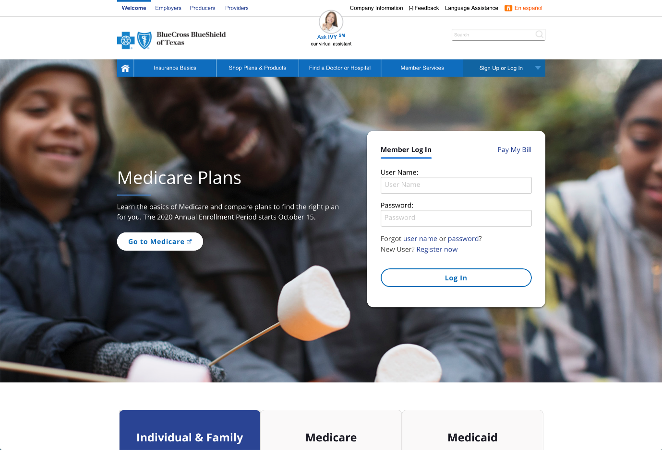

BAM Blue Access for MembersSM
Go to bcbstx.com and log in to Blue Access for Members
via web or mobile
Click Register Now if you are a new user
Get the Mobile App
Text BCBSTXAPP to 33633
bcbstx.com/mobile
Notes:
BAM

Slide 25

Blue Access for MembersSM
Save time
with self-service support tools
and health and wellness resources available through a convenient and secure website
  Find doctors, hospitals, or urgent care facility
  View benefits & claims
  View & print an Explanation of Benefits (EOB) for a claim
  Sign up for electronic EOBs and save paper
  Set your preferences & receive notifications
  Manage mobile and texting preferences
  Request new ID cards or print temporary ID cards
  View your prior authorization information
  Access health and wellness programs & resources
  Get details on wellness, discounts, 24/7 Nurseline
  … and more
  Log and perform protected transactions
  24 hours a day, 7 days a week*
*Claim Statements/EOBs are not available from 3 – 6 a.m.
Notes:
Blue Access for Members
You can save time using self-service support tools, including the following and more:
Check the status of a claim; view and print Explanation of Benefits (EOBs)
Request new ID cards; print temporary ID cards
Confirm who is covered under the plan
Check plan coverage details and Rx benefit information
Secure access – employers can log in to their accounts and perform protected transactions 24 Hours a day, 7 days a week* [*Claim Statements/EOB’s are not available from 3-6 a.m.]
NOTE:
Blue Access for Members is available to all members. Options available within the portal will vary depending on group membership and benefit selections.

Slide 26
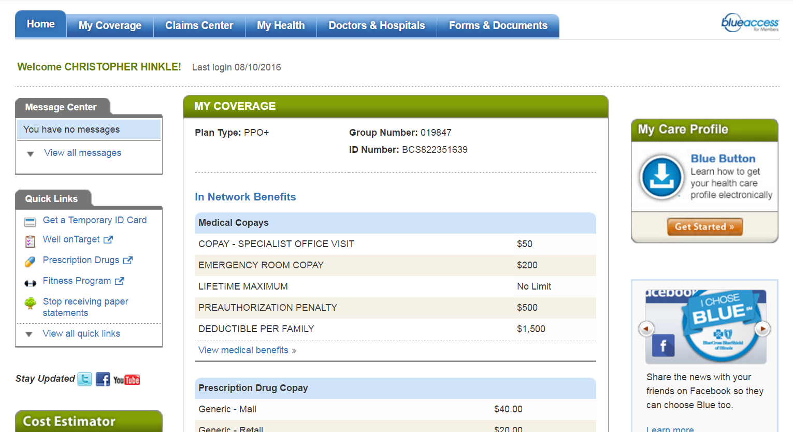
Navigating Blue Access for MembersSM
1
2
3
4
5
MEMBER NAME
Last login 08/01/2019
7
ABC123456789
6
1
My Coverage: Review benefit details for you and your covered dependents
Claims Center: View and organize details such as payments, claims status and more
My Health: Make more informed health care decisions by reading about health and wellness topics and specific conditions
Doctors & Hospitals: Use Provider Finder® to locate a network doctor, hospital or other health care provider
Forms & Documents: Use the form finder to get medical, dental, pharmacy and other forms quickly and easily
Quick Links: For easy access to member discounts, benefit programs and more
My Care Profile: Access and download a summary of provider visits, medications and test results
2
3
4
5
6
7
Screen images are for illustrative purposes only.
Notes:
More tools and resources to help you better understand and make the most of your health benefits
Learn about your plan coverage, order replacement ID cards, view and manage claims and much more
Research your options for care; Find and organize claims

Slide 27
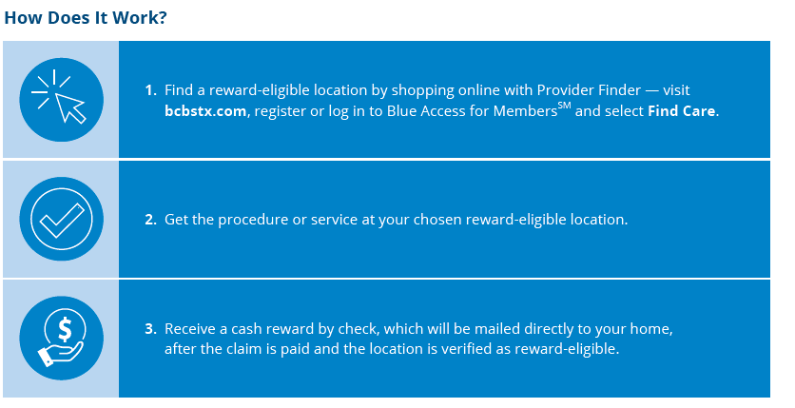
Compare Costs & You May Earn Cash with Member Rewards when choosing low-cost reward eligible options for procedures & services
NEW @ BCBS TX
MEMBER REWARDS
Notes:
Log into BAM – Select FIND CARE, get the procedure or service @ chosen reward-eligible location
Document – Receive a reward check after claim paid & location verified as reward-eligible
Be sure to formally go thru the process & document for your records

Slide 28



Well onTarget® can provide you personalized action plans, lets you sync your fitness device, join self-management programs and more.
24/7 Nurseline conveniently answers your health questions.
Fitness Program gives you access
to a network of gyms that fit your budget and lifestyle.
Women’s and Family Health provides support for cycle tracking, pregnancy and parenting.
Digital Health Partners
**Wondr – weight & stress management **Livongo – diabetes management **Omada – diabetes prevention & hypertension education **Hinge Health – musculosketal program lead by physical therapists
Your Health
and Wellbeing Programs
TO HELP YOU
FIT BETTER HEALTH
INTO YOUR SCHEDULE
Log in at bcbstx.com
Click the My Health tab
Notes:
BAM - health and wellness resources.
Hinge Health (back/joint), Livongo (hypertension), Omada (diabetes) Special beginnings (maternity support), Wondr (metabolic syndrome reversal)
‭========================
Well onTarget is a voluntary wellness program. Completion of the Health Assessment is not required for participation in the program.‭
Blue Points‭ Program Rules are subject to change without prior notice. See the Program Rules on the Well onTarget Member Wellness Portal at wellontarget.com for further information. Member agrees to comply with all applicable federal, state and local laws, including making all disclosures and paying all taxes with respect to their receipt of any reward.‭
A $25 enrollment fee and $25 monthly fee apply per member (subject to change). Taxes may apply. Individuals must be at least 18 years old to purchase a membership.
‭24/7 Nurseline is not available to IL HMO members. For medical emergencies, call 911. This program is not a substitute for a doctor’s care. Talk to your doctor about any health questions or concerns.

Slide 29

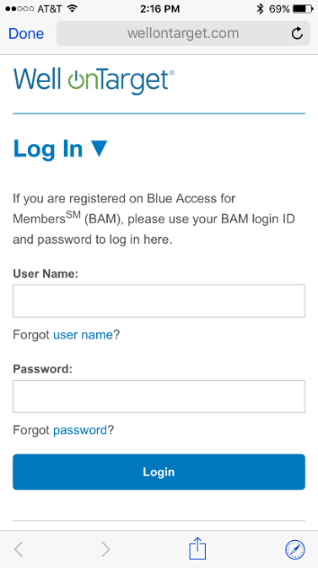
Member Wellness Portal
Well onTarget® Highlights
Health Assessment
Member dashboard
Digital self-management programs
Trackers and tools
Interactive symptom checker
Health and wellness content
Text message alerts
Fitness Program
Tracking for fitness and nutrition
and also device integration
Personal wellness challenges
Mobile app (AlwaysOn)
The newly designed portal includes recommended activities that make up your Personal Member Journey.
Screen images are for illustrative purposes only.
The Fitness Program is provided by Tivity Health™ Services, LLC, an independent contractor which administers the Prime® Network of fitness centers. The Prime Network is made up of independently-owned and managed fitness centers. Prime is a registered trademark of Tivity Health, Inc. Tivity Health is a trademark of Tivity Health, Inc.
Blue Cross®, Blue Shield® and the Cross and Shield Symbols are registered service marks of the Blue Cross and Blue Shield Association,
an association of independent Blue Cross and Blue Shield Plans.

Slide 30

24/7 Nurseline
Advice anytime…
Round-the-clock health and wellness advice from licensed nurses
Plus, you can also listen to more than 1,000 health topics
Call (800) 581-0368
Available in English & Spanish

Slide 31
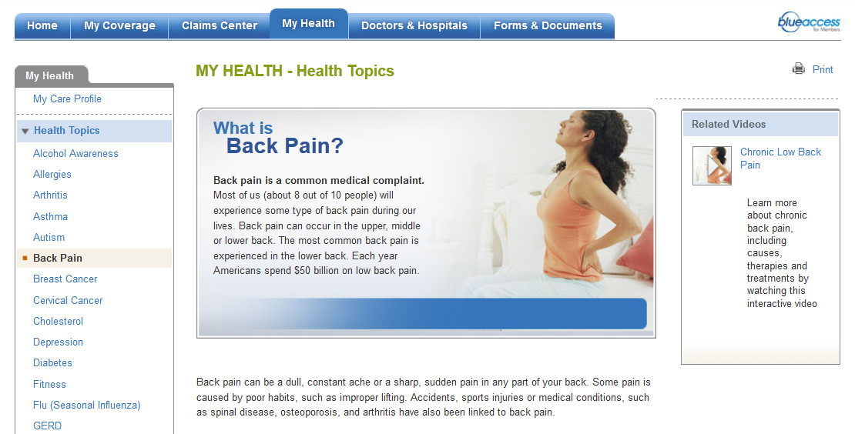
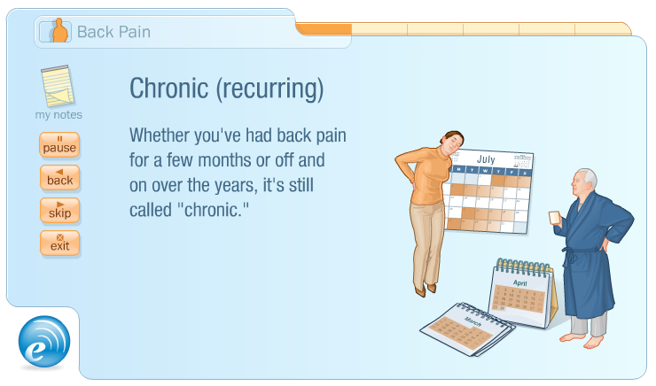
Interactive Video Tutorials
Easy to use, technology-powered video coaching modules that enable the most informed treatment decisions
Select a topic from the list at left to view available videos.
Topics include:
Coronary artery disease
Bariatric surgery
Chronic low back pain
Depression
Diabetes
Blood sugar
Insulin injections
Type 2 diabetes
Metabolic syndrome
Screen images are for illustrative purposes only

Slide 32


Blue365®
Member Discount Program
Member discounts simply for being a BCBSTX member
Sign up for weekly featured deals
Exclusive health and wellness deals
from national and local retailers
Save money on gym memberships, hearing aids, fitness devices nutrition-related services, & more
Log in to Blue Access for MembersSM
and click “Member Discount Program”
in Quick Links to view your
available discounts and to
register for weekly emails
Blue365 is a discount program only for BCBSTX members. This is NOT insurance. Some of the services offered through this program may be covered under your health plan. Employees should check their benefit booklet or call the Customer Service number on the back of their ID card for specific benefit facts. Use of Blue365 does not change monthly payments, nor do costs of the services or products count toward any maximums and/or plan deductibles. Discounts are only given through vendors that take part in this program and are subject to change. BCBSTX does not guarantee or make any claims or recommendations about the program’s services or products. Members should consult their doctor before using these services and products. BCBSTX reserves the right to stop or change this program at any time without notice.
Notes:
Save money on health & wellness products from top retailers; Sign up to receive weekly featured deals emailed
Nutrisystem, Reebok, Fitbit & more

Slide 33

Prescription Drug Benefit (Gold & Silver)
Lower Copays through a Preferred Pharmacy Network (PPN)
Locate a PPN at www.myprime.com
Higher Copays at a Non-Preferred Participating Pharmacy
Drug List Status | Preferred Retail Pharmacy (PPN) Copay (up to a 30-day supply) | Non-Preferred Retail Participating Pharmacy Copay (up to a 30-day supply) |  | Home Delivery (Mail Order) Copay (up to a 90-day supply)
Preferred Generic | $0 | $10 |  | $0
Non-Preferred Generic | $10 | $20 |  | $30
Preferred Brand | $50 | $70 |  | $150
Non-Preferred Brand | $100 | $120 |  | $300
 | Specialty Pharmacy (30-day supply)
Preferred Specialty / Non-Preferred Specialty* | $150 / $250
*Your plan may require that you use select specialty pharmacies to receive coverage for these medications.
Only a 30-day supply may be obtained at a time. See your benefit booklet for details.
Notes:
Walgreens, Walmart, Tom Thumb, HEB are PPN; CVS Non-Participating

Slide 34

MyPrime.com
Jane Doe
Single sign-on from
Blue Access for MembersSM to:
Locate a pharmacy
Find drugs/drug list
View prescription claim history
Create personal drug list
Learn about specific drugs
  Rx cost calculator
  Health information
Your Prescription coverage includes prior authorization, step therapy, quantity limits, & a preferred drug list
MyPrime.com is an online resource offered by Prime Therapeutics.
Prime Therapeutics LLC, a separate company, is a pharmacy benefit management company. Blue ‭Cross and Blue Shield of Texas (BCBSTX) contracts with Prime Therapeutics ‭to provide pharmacy benefit management and other related services. In addition, ‭contracting pharmacies are contracted through Prime Therapeutics. The ‭relationship between BCBSTX and contracting pharmacies is that of independent ‭contractors. BCBSTX, as well as several independent Blue Cross and Blue ‭Shield Plans, has an ownership interest in Prime Therapeutics.
Notes:
MyBlueRxTX
Locate a pharmacy
Find drugs/formulary
View prescription claim history
Create personal drug list
Learn about specific drugs
Rx Cost Calculator
Health information
PrimeMail
Refill a mail order prescription
Check the status of an order
Streamlined order refills
Manage payment options
Add alternative mailing address

Slide 35
Home Delivery Prescriptions
  Your pharmacy benefit includes mail service of your maintenance medications through Express Scripts Pharmacy Mail Order
  Visit express-scripts.com/rx
  Log in to myprime.com & follow the links to Express Scripts Pharmacy
  Once registered, ask your doctor to submit your prescription electronically or by fax
  Transfer your existing prescription from
  a retail pharmacy online or by phone
Call Express Scripts
(833) 715-0942
Available 24/7

Slide 36
Dependent Children under 19
Pediatric Dental & Vision benefits are included as part of the Medical Plan in addition to the BCBS Dental plan and the Vision plan through VSPnumber on dental ID card
For information on Pediatric Vision – please call Davis-Vision at 800/350-1534
Refer to BCBC Medical Booklet for Specific Details

Slide 37
Your Dental Plan (BCBS TX) Policy #299985
Annual Limit - $1,500
Calendar Year Deductible $50 individual (3x family)
Preventative 100% - deductible waived
Basic 80%
Major 50%
Lifetime Limit - Orthodontia - $1,500
Dependent Child to Age 19
Adults (Employee or Spouse)

Slide 38
Features of your dental plan
Preventive cleanings 100% no deductible
(two every 12 months)
Full Mouth X-rays once every 60 months
Fluoride to Age 19 (two every 12 months)
Sealants to age 16 (one per unrestored permanent molar)
Space Maintainers to age 19
(one appliance per missing tooth)

Slide 39
Your Vision Benefits Group #30069274
Vision Service Plan - Call 800/877-7195
Choice of Providers -- Choose a VSP doctor, a participating retail chain, or any out-of-network provider
The largest network of independent eye doctors - VSP vision insurance is accepted by more than 34,000 doctors nationwide
Tell the provider you have VSP – NO ID Cards is necessary – You can print one at vsp.com
No claim forms to complete when you see a VSP network provider

Slide 40
Your Network Vision Benefits
Frequency of Vision Benefits
Exam – Every 12 Months
Lenses – Every 12 Months
Frames – Every 24 Month
Routine Eye Exam - $20 Copay
Contacts exam - up to $60 copay (plus exam copay)
Materials - $20 Copay Glasses or Contacts

Slide 41
Your Network Vision Benefits
Frame Allowance - $250
Featured Frame Allowance - $270
Contact Allowance - $250
Minor Eye Medical Condition - $20 Copay
Routine Retina Screening – Up to a $39 Copay
20% Discount on amounts over allowance or extra pair of glasses within 12 months of exam

Slide 42

Special Offers through VSP
Select from Extensive List of Featured Brands & receive ADDITIONAL $20 Allowance for Featured Frames
Rebates for contact lens, coupons, & other discounts

Slide 43
Register with VSP
24/7 access to your VISION claims and account information
www.vsp.com

Slide 44
Your Survivor & Disability Benefits
Reliance Standard Life (RSL)
Basic Life/AD&D - $50,000
Long Term Disability – 60% of salary to $6,000/month after 90 days of disability
Paid for by JBI, Ltd.
Option to Purchase Additional Term Life/AD&D Insurance

Slide 45
Option to Purchase Voluntary Term Life/AD&D Insurance
Available through Reliance Standard Life (RSL)
Choices of life insurance, for Employee and/or Spouse in increments of $10,000 to $500,000
Rate based on Age as of Sept. 1st
(adjusts once per year)

Slide 46
Option to Purchase Voluntary Term Life/AD&D Insurance
Spouse coverage based on Spouse Age (not EE Age)
Portability Included (at different rates)
Paid by Employee – After Tax Dollars
Child Life Only coverage $10,000
$1.62 per month or $.75 bi-weekly

Slide 47
Reliance Standard Life
Employee under age 60 - $100,000
(60-70 $10,000)
Spouse under age 60- $50,000
Voluntary Term Life Guarantee Issue available if Enrollment occurs when 1st Eligible
Notes:
SPECIAL **** Guarantee Issue - $50K EE to age 60; $10K Sp to age 60; $10K EE 60-70 if not previously declined or exhausted guarantee issue

Slide 48
You Can Pay Health Insurance Premiums with Pre-Tax Dollars through Section 125 – Significant Savings

Slide 49
Section 125 Components
1. Health Plan Premiums
2. Pre-Tax Out of Pocket Health Expenses
- Health FSA
3. Pre-Tax Dependent Day Care Expenses
- Dependent Care FSA

Slide 50

What is the cost for Health Insurance?
Identify your tax bracket to determine Pre-Tax savings
Determine your Federal Income Tax (FIT) Bracket plus 7.65% FICA Taxes to calculate your Pre-Tax Savings

Slide 51

Do you know how much you pay in Taxes?
FICA – 7.65%
PLUS
Your Federal Income
Tax Rate
2018 Tax reform tax brackets
10%, 12%, 22%, 24%, 32%, 35%, & 37%
Depending on where you live…
You may also pay State & Local Taxes

Slide 52
What is your Federal Income Tax (FIT) Tax Bracket
2025 Tax Brackets and Rates
Rate | For Single Individuals, Taxable Income Over | For Married Individuals Filing Joint Returns, Taxable Income Over | For Heads of Households, Taxable Income Over
10% | Up to $11,925 | Up to $23,850 | Up to $17,000
12% | $11,925 to $48,475 | $23,850 to $96,950 | $17,000 to $64,850
22% | $48,475 to $103,350 | $96,950 to $206,700 | $64,850 to $103,350
24% | $103,350 to $197,300 | $206,700 to $394,600 | $103,350 to $197,300
32% | $197,300 to $250,525 | $394,600 to $501,050 | $197,300 to $250,500
35% | $250,525 to $626,350 | $501,050 to $751,600 | $250,500 to $626,350
37% | Over $626,350 | Over $751,600 | Over $626,350
Source: Internal Revenue Service
Federal Income Tax (FIT) Bracket plus 7.65% FICA Taxes equals your Pre-Tax Savings
12% Bracket = .1965 22% Bracket = .2965 24% Bracket = .3165 32% Bracket = .3965
The standard deduction in 2025 is $15,000 single, $30,000 married/filing joint, $22,500 head of household
Maximum earnings subject to 6.2% Social Security in 2025 is $176,100. There is no cap on 1.45% Medicare tax.
Additional .9% Medicare tax for Modified Adjusted Gross Income of more than $200,000 ($250,000 married filing jointly).
This is not tax advice. This material has been prepared for informational purposes only, and is not intended to provide tax advice. You should consult your own tax, legal, and accounting advisors for advice.

Slide 53
How much do you have to earn in the 22% Tax Bracket to take home $300?
22% Tax Bracket
Gross Earnings $ 426.44
FICA (7.65%) -$ 32.62
FIT -$ 93.82
Net Earnings $300.00
$126.44 in Taxes
Paying for Health Insurance Premiums with
Pre-Tax results in Substantial Savings
Notes:
If in the 12% tax bracket, $73.36 in Taxes
Gross Earnings $373.37 for $300 net

Slide 54
IRS Rules
All Elections are made Prospectively
No changes unless Life Changing Event
Corresponding to the Life Changing Event
Limited Health FSA mid year changes
Use it or Loose It
Changes can be made January 1st of each year

Slide 55
What is a Life Changing Event?
Your Marriage or Your Divorce
Birth or Adoption of Your Child
Death / Termination of your dependent relationship
Change of Job/Job Status by You or Your Spouse
Other situations as determined by IRS

Slide 56
I already pay my health premiums with pre-tax dollars …
What else can I do to lower my taxes?

Slide 57
Consider Setting up Flexible Spending Accounts (Plan Year = Calendar Year)
Health FSA
Maximum $3,300 per year (Cal. Year 2025)
Dependent Care FSA
Maximum $5,000 per year

Slide 58
Plan Year - Flexible Spending Accounts
Calendar Year - January 1st to December 31st
Plus a 2 ½ month grace period
Equals
14 ½ months to Incur eligible Claims

Slide 59
What is Health Flexible Spending Account?
A Pre-Tax Health Spending Account
Spending Account to pay for out of pocket medical, dental, & vision expenses (not covered by ANY insurance)
Health FSA is for You & Your dependents, even if not covered under medical plan
Funds are available 1st day of the plan year if you incur an eligible expense & file a claim

Slide 60
Health FSA Examples
IRS Section 213
Prescription Copays
Office Visit Copays
Deductible
Coinsurance (Your Portion)
Vision
Orthodontia
Over the Counter medications (added under Cares Act 2020)
Menstrual products (added under Cares Act 2020)
Some items it excluded are pre-payment of services, supplements, health club dues, and cosmetic services
Notes:
OTC & Menstrual added 1/1/2020 under Care Act – - OTC does not require a Prescription under Cares Act & is retro to 1/1/2020; stockpiling (3 or more of any one item) is not allowed

Slide 61
You cannot claim the tax deduction for medical expenses and Health FSA
Medical Expenses must exceed
7.5%
of income to be eligible for a tax credit
Notes:
Permanent Reset the deduction to 7.5% for 2021 & later

Slide 62
What is Dependent Care FSA?
A Pre-Tax Dependent Day Care Account
Reimburses for daycare costs for your child (up to age 13 years) or a disabled adult you are legally responsible
Eligible if You & Your spouse (if married) are working or are full-time students
You must incur & file an eligible claim -
Funds are available ONLY once deposited in the account

Slide 63
You Cannot claim both the tax credit & use Dependent Care FSA
Which is better in your situation?

Slide 64
Tax Credit versus Dependent Care FSA
Tax Credit
$3,000 per child (max. 2 children)
Tax Credit % - 20% to 35% depending on salary
Dependent Care FSA
$5,000 maximum limit
Tax Savings = Federal Tax Bracket + 7.65% FICA

Slide 65
What is better for me?
(Tax Credit versus Dependent Care FSA)
Depends on your income, number of children, & child care costs
Complete the Flex Worksheet within the FSA Enrollment/Worksheet
You may choose Dependent Care FSA OR take a year-end tax deduction – (but not both)

Slide 66
FSA Administrator
Ameriflex
www.myameriflex.com
Participant Services Team – (888) 868-3539
Register with Ameriflex 24/7 access to your FSA claims and account information
All FSA claims incurred in 2024 must be submitted to United Healthcare prior to 3/15/2025 for reimbursement - Contact UHC at
(877) 797-7475 for information on 2024 FSA claims

Slide 67
Your Supplemental Insurance Benefits
Cancer
Accident
Medical Bridge
Critical Illness
Notes:
Colonial Life – Supplemental benefits

Slide 68
Colonial Life
Supplemental Insurance
Benefits are Portable Even if you Terminate
At Issue Age
Colonial pays you directly…
in addition to health insurance
Notes:
Individual Policies
Enrollment in Medical Plan not required

Slide 69
Colonial Life
Supplemental Insurance
Colonial pays you directly, in addition to health insurance
30 day waiting period for Cancer, Critical Illness, & Wellness/Health Screenings
Colonial benefits are at the Issue Age if you terminate & wish to continue coverage
Guaranteed Renewable
Notes:
Pays IN ADDITION to health plan
Issue Age
Individual Policies – can be customized

Slide 70
Colonial Life
Supplemental Insurance
Supplemental Policies are Individual Policies
Minimal Underwriting
Duplication of Colonial Policies Not Permissible
Colonial does not Coordinate with your Medical Insurance policy
Notes:
Cannot Duplicate Colonial policies
No Coordination with Medical policy

Slide 71
Accident, Medical Bridge, & Cancer
Paid with Pre-Tax $
Review the Cost Example in your Tax Bracket
Examples available for 22%, 12%, 24%, & 32% Tax Bracket – see Colonial Packet or Benefit Website for examples
Examples found under Supplemental Summaries of Health Benefit Resources at
www.thediamondbenefitgroup.com/jbi-ltd/
Notes:
Examples on Website
Various Tax Brackets

Slide 72
What is your Federal Income Tax (FIT) Tax Bracket
2025 Tax Brackets and Rates
Rate | For Single Individuals, Taxable Income Over | For Married Individuals Filing Joint Returns, Taxable Income Over | For Heads of Households, Taxable Income Over
10% | Up to $11,925 | Up to $23,850 | Up to $17,000
12% | $11,925 to $48,475 | $23,850 to $96,950 | $17,000 to $64,850
22% | $48,475 to $103,350 | $96,950 to $206,700 | $64,850 to $103,350
24% | $103,350 to $197,300 | $206,700 to $394,600 | $103,350 to $197,300
32% | $197,300 to $250,525 | $394,600 to $501,050 | $197,300 to $250,500
35% | $250,525 to $626,350 | $501,050 to $751,600 | $250,500 to $626,350
37% | Over $626,350 | Over $751,600 | Over $626,350
Source: Internal Revenue Service
Federal Income Tax (FIT) Bracket plus 7.65% FICA Taxes equals your Pre-Tax Savings
12% Bracket = .1965 22% Bracket = .2965 24% Bracket = .3165 32% Bracket = .3965
The standard deduction in 2025 is $15,000 single, $30,000 married/filing joint, $22,500 head of household
Maximum earnings subject to 6.2% Social Security in 2025 is $176,100. There is no cap on 1.45% Medicare tax.
Additional .9% Medicare tax for Modified Adjusted Gross Income of more than $200,000 ($250,000 married filing jointly).
This is not tax advice. This material has been prepared for informational purposes only, and is not intended to provide tax advice. You should consult your own tax, legal, and accounting advisors for advice.

Slide 73
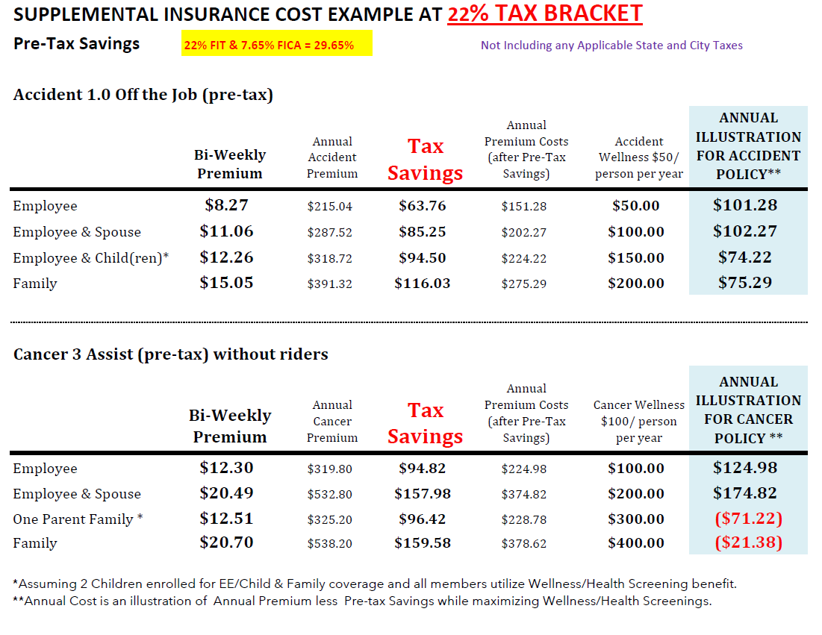

Slide 74

Accidents can happen ANY TIME
Accidents can happen anywhere …
Broken bones
Sports-related accidental injury
Burn
Back or knee injuries
Concussion
Laceration
Car accidents
Falls & spills
Dislocation

Slide 75
Accident Policy
Pays for Doctor Visits, ER, Urgent Care, X-ray, Hospital Admission, Accidental Death & more
$50 Health Screening after 30 day waiting period
Premiums Paid with Pre-Tax Dollars
Includes Children in Sports
Pays $125 for Initial Accident plus amount of Scheduled Benefit
Notes:
$125 Initial – 3 Followups @$50
If app in Tx – Use Tx policy
GA & CT – No wellness; Illinois, Ohio, South Carolina very comparable
PA has higher rates but slightly higher benefits
Florida has lower rates but higher benefits
Indiana, Kentucky, & New York have comparable rates but higher benefits
Accidental Death: TX, IL, OH, PA, SC, TN, CT, & NJ = $25K GA & NY & FL = $40K KY = $50K IN = $75K

Slide 76
ACCIDENT EXAMPLES OF ELIGIBLE BENEFITS
Refer to Outline of Coverage for Complete List of Scheduled Benefits
Ambulance $200 Air Ambulance $2,000
Fracture Closed Reduction up to $2,750 Open Reduction up to $5,500
Hospital Admission - $1,000 Hospital Intensive Care $2,000
Physical/Occupational Therapy $25/day Rehabilitation Unit $100/day (15 days)
Eye Injury $300 Emergency Dental Work $75 - $300 Burn $1,000 to $12,000
Appliance $100 Xray $30 Medical Imaging $150
Hip Fracture $1,650 (closed reduction ) to $3,300 (open reduction)
Knee Cartilage Torn $500 Knee Dislocation $1,100 to $2,200
Laceration repair $60 to $500
Tendon / Ligament / Rotator Cuff $500 to $1,000
Accidental Dismemberment $750 to $15,000 Prosthetics $500 to $1,000
Accident Emergency Treatment ($125) - 3 Follow-ups Doctor Visits at $50
Concussion $60 Coma $10,000
Hospital Confinement - $225/day (365 days) Intensive Care $450/day (15 days)
Dislocation Closed Reduction up to $2,200 Open Reduction up to $4,400
Surgery (Exploratory & Arthroscopic) $200 Surgery (Cranial, Abdominal & Thoracic) $1,500
Notes:
TX Limits
Concussion - $60; Ambulance $200 (air $2,000); PT $25 for 10 days; Prosthetics - $500 to $1,000
Transportation $500/trip (3 rounds); Medical Imaging $150/once CY
Hospital admission $1,000 ($225/day up to 365 days); ICU $2,000 ($450/dayup to 15 days)

Slide 77
Accident Health Screening
$50 Health Screening benefit per year
per person after 30 day waiting period
Some Examples of Eligible health screening for Accident policy
Blood test for Triglycerides
Serum Cholesterol Test for HDL/LDL Levels
Mammogram
Fasting Blood Glucose Test
Pap Smear
Blood Test for Colon Cancer
Stress test on bike/treadmill
PSA
See outline of Coverage for complete list of eligible health screenings in Accident policy

Slide 78
Diagnosed with Cancer
Review Cancer Outline of Coverage
Help when you need it most --
Some examples include
Hospital Confinement
Ambulance
Nursing Services
Radiation/Chemotherapy
Experimental Treatment
Transportation/Lodging
Surgical Procedures
If cancer impacts your life, you should be able to focus on getting better – not on how to pay your bills
Benefits are paid directly to YOU

Slide 79
CANCER ASSIST POLICY
See Cancer Assist Outline for Scheduled Benefits
Pays you if diagnosed with Cancer –
Affordable premiums paid with pre-tax dollars
Waiver of Premium
Included if name insured is disabled due to cancer for longer than 90 consecutive days & date of diagnosis is after waiting period of in force policy
No lifetime limits
$100 Cancer Assist screening/wellness per covered person
30 day waiting period
Optional Riders available
  Specified Disease
  Initial Diagnosis
  Progressive Payment

Slide 80
Cancer Supplemental Policies
Review Cancer Outline of Coverage
(Cancer 1000 or Cancer Assist)
Cancer Assist – Policies enrolled since 9/2016
Cancer 1000 – Policies written before 9/2016
Existing Cancer 1000 participants automatically remain under current Cancer 1000 policy -
If participant requests to replace Cancer 1000 with Cancer Assist, 30 day waiting
period waived with policy transfer if approved. Refer to Outline of Coverages
for differences between Cancer1000 & Cancer Assist

Slide 81
Cancer Wellness
30 day waiting period
Colonoscopy & Virtual colonoscopy
Mammography
Pap Smear & ThinPrep pap test
PSA (blood test for prostate cancer)
Serum Protein Electrophoresis (blood test for Myeloma)
CA 15-3 (blood test for breast cancer)
CA125 (blood test for ovarian cancer)
CEA (blood test for colon cancer)
Flexible sigmoidoscopy
Hemoccult stool analysis
Thermography
Chest x-ray
Bone Marrow Aspiration/Biopsy
Biopsy of Skin Lesion
Breast Ultrasound
CancerAssist policies include $100 reimbursement for Health Screening tests: Blood test for Triglycerides, Carotid Doppler, ECHO, EKG, ECG, Fasting Blood Glucose, Serum Cholesterol for HDL/LDT, Stress test on bicycle/treadmill
PART 1 – Wellness Pays $100 per person per calendar (Cancer Assist)
PART II – Pays you $100 for additional invasive diagnostic procedure (as a result of an abnormal cancer screening test)

Slide 82
Medical Bridge (Hospital Income)
Medical Bridge IMB7000 Available for New Participants
IMB 7000
Hospital inpatient –
Choice of $1,000 or $2,000 hospital admission
Outpatient Surgery - $750 Tier 1; $1,500 Tier 2
CYM outpatient $2,500
Optional Riders
Daily Hospital - $100/day up to 365 days
Enhanced ICU - $500/day up to 30 days per confinement

Slide 83
Medical Bridge (Hospital Indemnity)
IMB7000
Observation Room
Pays $100 per visit
Calendar Year Maximum Two (2) Visits
Rehabilitation Unit Confinement
Pays $100 per day up to 15 days
Calendar Year Maximum 30 days
    Inpatient Rehabilitation immediate following hospital confinement either in a unit that is part of a hospital or free-standing facility
Waiver of Premium
After 30 continuous days of covered hospital confinement or rehabilitation unit confinement of the name insured
Notes:
MB3000 – Rehab CYMax is $3K not 30 days; Observation room does NOT apply to MB300

Slide 84
Medical Bridge (Hospital Indemnity)
IMB7000
Pays you lump sum for hospital confinement or outpatient surgery
$50 wellness per person per calendar year after 30 days for IMB7000
Rates are Age Banded (premiums paid with pre-tax dollars)
17-49 50-59 60-64 65-74
Covers pregnancy (policy must be in force for 10 mos.)
Pre-Existing limitation – generally for first 12 Months
Same accident/sickness within 90 days – continuation of previous confinement

Slide 85
Medical Bridge Supplemental Policies
IMB7000 –MB Policies since 9/1/2019
MB3000 DB & DD – Policies enrolled 9/2017 to 8/2019
MB3000 BB & BD – Policies written before 9/2017
Participants who were enrolled in Medical Bridge3000 plans (BB, BD, DB, & DD) prior to September 1, 2019 will be grandfathered but are eligible to apply for a transfer to the IMB7000 Medical Bridge at existing age at time of application. If new policy is approved, policy will be transferred. Medical Bridge 3000 wellness benefits limited to 2 per family/year & does not include observation room benefit.
Notes:
Considerations to Change:
Age Bracket Changes
Outpatient Benefit (New is higher than phase 1 but lower than phase 2)
Wellness is $50 per person (if family covering 3+ members – new is better plan)

Slide 86
Critical Illness
Pays 100% of Lump Sum Benefit you Select
Heart Attack
Stroke
Major Organ failure
End State Renal - Kidney failure
Coma
Blindness
Permanent Paralysis due to Covered Accident
Occupational effectious HIV or Hepatitis B, C, D
Pays 25% for Coronary Artery Bypass Graft Surgery
Review Critical Illness Outline of Coverage

Slide 87
Critical Illness
Premiums are based on Your Age, Tobacco Status, & Amount of Coverage
Initial 30 Day Waiting Period
Pre-existing limitation generally for12 months
Maximum benefit amount is reduced by 50% on anniversary date after age 75
Premiums paid with After Tax Dollars

Slide 88
Critical Illness
You select Lump Sum benefit between $5,000 to $75,000 in $1,000 increments; Includes Subsequent Diagnosis
Maximum Policy benefit is Three (3X) Initial Lump Sum
Family coverage includes Spouse at 50% and children at 25% of name insured
No additional premium to add Children but they are eligible for health screening
$50 health screening per person/year after 30 day waiting period

Slide 89
Critical Illness Health Screening
$50 Health Screening benefit per year
per person after 30 day waiting period
Few Examples of Eligible health screening for Critical Illness Policy
Blood test for Triglycerides
Serum Cholesterol Test for HDL/LDL Levels
Mammogram
Pap Smear
Fasting Blood Glucose Test
Blood Test for Colon Cancer (CEA)
PSA
Please refer to Outline of Coverage for Complete List of Health Screenings

Slide 90
Critical Illness Cost Example for Non-Smoker
Age 31, Lump Sum $7,000 Employee coverage for Critical Illness
Cost per Pay Period $2.25 (after-tax)
Annual Premium $58.56
Health Screening Reimbursement $50
Net Annual Cost - $8.56 ($58.56 minus $50)

Slide 91
Critical Illness Cost Example for Non-Smoker
Minimal differences due to rounding may apply
Age 42, Lump Sum $5,000 Employee and $2,500 Spouse coverage for Critical Illness
Cost per Pay Period $4.32 (after-tax)
Annual Premium $112.20
Health Screening Reimbursement $100 ($50 each)
Net Annual Cost - $12.20 ($112.20 minus $100)

Slide 92
Register with Colonial Life for 24/7 access to your Supplemental insurance claims and account information
www.coloniallife.com/register
Select policyholder website
Customer Service (800) 325-4368

Slide 93
Questions ?
Human Resources Manager, Bob Kimbrell
Health Benefits Consultant, Debbie Fleck

