Slide 1
Summary of EMPLOYEE Health Benefits
JBI, LTD
Effective September 1, 2022

Slide 2
Health Plan Annual Open Enrollment
Open Enrollment
Open enrollment every August
Changes can be made to health coverage selections during open enrollment
Health Benefit Resources
www.thediamondbenefitgroup.com/jbi-ltd/
Notes:
Not open enrollment for FSA - Calendar Year for FSA accounts
Deadline Monday, August 22rd

Slide 3
Annual Health Plan Open Enrollment Effective 9/1/2022
Offer a Choice of Two Medical Plan Options
– One Gold and One Silver (no changes)
Dental Benefits (no changes)
Vision Benefits (no changes)
Survivor & Disability Benefits (no changes)
Includes Company Paid Life/AD&D & LTD
Includes EE Paid Voluntary Term Life/AD&D Insurance
Supplemental Benefits (no changes)
Includes EE Paid Accident, Cancer, Medical Bridge, & Critical Illness
Notes:
Added Dual Option Sept. 2017
Gold & Silver Metallic options
Dental, Vision, Life, Disability, Supplement – NO Changes

Slide 4
What Benefits are Offered?
Two Medical Options (includes Rx)
Blue Cross Blue Shield (BCBS)
Dental
BCBS
Vision
Vision Service Plan (VSP)
Basic Term Life/AD&D
RSL
Long Term Disability
RSL
Voluntary Term Life
RSL
Supplemental Insurance
Colonial Life
Notes:
All carriers remain the same
Medical – GOLD & SILVER
New Gold

Slide 5
Your Supplemental Insurance Benefits
Cancer
Accident
Medical Bridge
Critical Illness
Notes:
Colonial Life – Supplemental benefits

Slide 6
Other Services Available to You with RSL
24-hour Travel Assistance through On Call International
Identity Theft Restoration Services through InfoArmor
Bereavement Support Services through ACI Specialty Benefits
Notes:
Provided through RSL

Slide 7
COBRA Monthly Rates for Health Coverage (Medical/Dental/Vision) Effective 9/1/2022
Silver Option
EE Only $821.75
EE & SP $1,639.78
EE & CH $1,660.82
FAM $2,505.58
Gold Option
EE Only $942.25
EE & SP $1,880.77
EE & CH $1,901.80
FAM $2,867.06
Notes:
Medical/Dental/Vision Rates plus 2%
Package (M/D/V)

Slide 8
What is your Federal Income Tax (FIT) Tax Bracket
2022 Tax Brackets and Rates
Rate | For Single Individuals, Taxable Income Over | For Married Individuals Filing Joint Returns, Taxable Income Over | For Heads of Households, Taxable Income Over
10% | $0 | $0 | $0
12% | $10,275 | $20,550 | $14,650
22% | $41,775 | $83,550 | $55,900
24% | $89,075 | $178,150 | $89,050
32% | $170,050 | $340,100 | $170,050
35% | $215,950 | $431,900 | $215,950
37% | $539,900 | $647,850 | $539,900
Source: Internal Revenue Service
Federal Income Tax (FIT) Bracket plus 7.65% FICA Taxes equals your Pre-Tax Savings
12% Bracket = .1965 22% Bracket = .2965 24% Bracket = .3165 32% Bracket = .3965
The standard deduction in 2022 is $12,950 single, $25,900 married/filing joint, $19,400 head of household
This is not tax advice. This material has been prepared for informational purposes only, and is not intended to provide tax advice. You should consult your own tax, legal, and accounting advisors for advice.

Slide 9
EE Contributions for Benefits Package (Medical/Dental/Vision) Per Pay Period - Paid with Pre-Tax Dollars
Employee Contributions
Per Pay Period beginning 9/1/2022
Silver Option
EE Only $55.78
EE & SP $203.83
EE & CH $207.64
FAM $360.54
Gold Option
EE Only $106.13
EE & SP $304.54
EE & CH $308.34
FAM $511.59
Notes:
Assuming 22% FIT + 7.65% - no state/local taxes = 29.65%
Gold family @ 22% bracket - $152 svg (equates $360/pp); 12 mos Tax svgs $3,944
Silver family @ 22% bracket - $99 svg (equates to $235/pp); Silver sgl $15 svg / equates $36/pp

Slide 10
More Doctors … More Hospitals
95% of doctors
96% of hospitals
1.4+ million Providers
More than 8,900 Hospitals
BCBS
Nationwide Coverage when traveling or living outside of home state
Blue Cross Blue Shield Global® Core coverage when traveling in 200+ countries and territories
Notes:
BlueCard program also allows members who need care when traveling to access their benefits
April 2019 Providers: 1,319,950 (315,774 PCPs/572,166 specialists/432,010 non-MD/DO)` Hospitals: 7,757 Global

Slide 11
PPO – How It Works
Out-of-Network Providers
DISADVANTAGES
You do have coverage, but
You pay a greater share of the costs
You may receive fewer benefits out-of-network
You may need to file your own claims
You may be billed for charges over the allowed amount (balance billing)
In-Network Providers
ADVANTAGES
Receive the highest level of benefits and potentially pay less for care
Protection from billing over the allowed amounts (balance billing)
No claim forms (provider files claim)
No referrals required
No requirement to select a PCP
Access to a national PPO network

Slide 12
How do I find a contracting provider?
Go to Provider finder at BCBSTX.COM
Log on to your Blue Access for Members (BAM) account
Call Customer Service
(# located at back of ID card)
BCBS Global Core (Blue Card) available for international benefits
(800) 810-2583 www.bcbsglobalcore.com

Slide 13
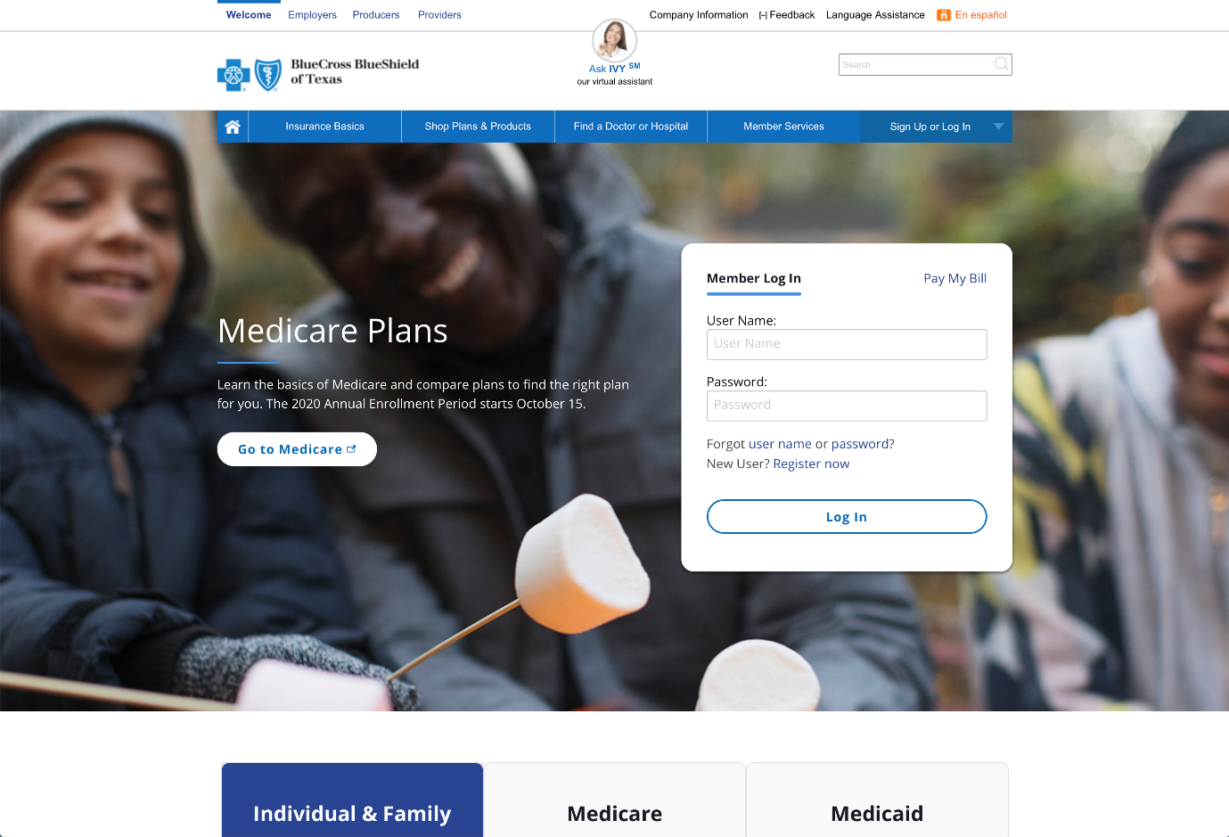
BAM Blue Access for MembersSM
Go to bcbstx.com and log in to Blue Access for Members via web or mobile
Click Register Now if you are a new user
Get the Mobile App
Text BCBSTXAPP to 33633
bcbstx.com/mobile
Notes:
BAM

Slide 14
Blue Cross and Blue Shield of Texas
More Doctors and Hospitals
Coverage Everywhere You Go
Personalized Customer Service
Health and Wellness Programs
Tools and Resources
Digital Capabilities
Notes:
95% of doctors and 96% of hospitals nationwide
Health and Wellness programs that help you stay healthy and manage any ongoing conditions
Digital/mobile technology and programs help you access and manage your health and wellness information

Slide 15
BCBS TX Medical Comparison – #120534 Options at a Glance (Gold Versus Silver)
Benefit | Gold (G652CHC-820) |  | Silver (S665CHC-834)
 | In-Network | Out-of-Network | In-Network | Out-of-Network
Individual Deductible | $1,500 | $3,000 | $3,250 | $6,500
Family Deductible | $4,500 | $9,000 | $9,750 | $19,500
Coinsurance Percentage (after deductible) | 80% In Network 60% Out of Network |  | 60% In Network 60% Out of Network
Individual Out-of-Pocket Max | $5,000 | NA | $8,550 | NA
Family Out-of-Pocket Max | $10,000 | NA | $17,100 | NA
Office Visit / Specialist | $40 / $80 | 60%* | $50 / $80 | 60%*
Preventative Care | 100% | 60%* | 100% | 60%*
Lab-X-ray | 80%* | 60%* | 60%* | 60%*
Preventive Care | 100% | 60%* | 100% | 60%*
Inpatient Admission | Ded/Coins* | Ded/Coins* | $250, Ded/Coins* | $350, Ded/Coins*
Outpatient Surgery | Ded/Coins* | Ded/Coins* | $200, Ded/Coins* | $300, Ded/Coins*
Emergency Room | $500, then Ded/Coins* |  | $500, then Ded/Coins*
Urgent Care | $100 | 60%* | $100 | 60%*
*Subject to deductible and coinsurance
Refer to Schedule of Coverage or Booklet for a more comprehensive summary of all benefits.
Notes:
Definitions – Deductible, Coinsurance, OOP, Copay

Slide 16
Your Medical Plan in Network
Apply to the PPO Maximum Out of Pocket
PPO Deductible
PPO Coinsurance (%)
PPO Copays
PPO Copays include office visit, specialist, Rx, urgent care, hospital inpatient, outpatient surgery, & ER
Copays do NOT apply to the Deductible
Once PPO Out-of-Pocket Maximum is met, eligible claims will be covered at 100% for rest of calendar year
Notes:
Deductible, Coinsurance, Copay, Max. OOP

Slide 17
Gold versus Silver Option You have PPO outpatient bill is $6,000 after PPO discount
Gold Option
You Pay Deductible of $1,500
You Pay 20% coinsurance of remaining $4,500 ($900)
20% of $4,500 is $900 coinsurance
Your Cost $2,400
($1,500 + $900 = $2,400)
Gold Plan Pays $3,600
If $1mil claim, Your Cost = $5,000
Silver Option
You Pay Deductible of $3,250
You Pay Outpatient Copay of $200
You Pay 40% coinsurance of remaining $2,550 ($1,020)
40% of $2,550 is $1,020 coinsurance
Your Cost $4,470
($3,250 + $200 + $1,020 = $4,470)
Silver Plan Pays $1,530
If $1mil claim, Your Cost = $8,550
Notes:
Gold Claim of $19,000 will reach Max. OOP ($1,500 Deductible + $3,500 OOP)
Silver claim (inpatient copay) of $16,125 will reach Max. OOP ($3,250 Deductible+ $250 Inpatient Copay+ $5,050 OOP)

Slide 18
PPO Medical Office Visit / Consultation
GOLD
Primary Care $40 Copay
Specialist $80 Copay
SILVER
Primary Care $50 Copay
Specialist $80 Copay
Office visit copay applies ONLY to office visit (primary or specialist)

Slide 19
Lab & X-ray
Deductible & Coinsurance applies to Routine Lab & X-ray regardless of place of service
Deductible & Coinsurance applies for Lab & X-ray performed in the doctor’s office or at a free-standing lab)

Slide 20
IN NETWORK IMAGING SERVICES (MRI, CT, Pet Scans)
Gold Option
$250 (no deductible)
Silver Option
60% after Calendar Year Deductible

Slide 21
Virtual Visits
CONNECT
Access where mobile app, online video or telephone service is available
INTERACT
Real-time consultation with an independently contracted, board-certified doctor or therapist
DIAGNOSE
Prescriptions sent to a pharmacy of your choice (when appropriate)
To register, you’ll need to provide your first and last name, date of birth and BCBSTX member ID number.
Notes:
Website: Visit the website MDLIVE.com/bcbstx
• Choose a doctor; • Video chat with the doctor• You can also access through Blue Access for Members
Mobile app: • Download app from Apple App Store, Google Play Store or Windows® Store
• Open the app and choose a doctor • Video chat with the doctor from your mobile

Slide 22
Virtual Visits
MDLIVE.com/bcbstx
Virtual visits provides a live consultation between a doctor and a member for non-emergency medical issues 24/7
Doctors are available on demand or by appointment
Call MDLIVE (888) 680-8646
Office Visit Copay (based on CPT code)
Connect online for real-time consultation with board-certified doctor or therapist

Slide 23
24/7 Nurseline
Advice anytime…
Round-the-clock health and wellness advice from licensed nurses
Plus, you can also listen to more than 1,000 health topics
Call (800) 581-0368
Available in English & Spanish

Slide 24
Your Medical Plan (BCBS TX)
PPO Urgent Care Center Visit at Urgent Care Facility–
Gold option - $100 copay
Silver option - $100 copay
Important: Ask if Provider is licensed as an Urgent Care Facility OR a Freestanding Emergency Room
Copay applies for consultation - other services received during Urgent Care visit are subject to deductible & coinsurance
Notes:
ER – both plans $500 ER copay, then metallic level deductible & coinsurance

Slide 25
Your Prescription Coverage
Prescription Coverage - Same for Gold & Silver Option
Preferred Pharmacy Network (PPN)
Includes Walgreen’s & Walmart
Lower Copays through Preferred Pharmacy Network
Your Prescription coverage includes prior authorization, step therapy, quantity limits, & a preferred drug list

Slide 26
Prescription Drug Benefit Preferred & Non-Preferred Pharmacy Network
Drug List Status | Preferred Retail Pharmacy (PPN) Copay (up to a 30-day supply) | Non-Preferred Retail Participating Pharmacy Copay (up to a 30-day supply) |  | Home Delivery (Mail Order) Copay (up to a 90-day supply)
Preferred Generic | $0 | $10 |  | $0
Non-Preferred Generic | $10 | $20 |  | $30
Preferred Brand | $50 | $70 |  | $150
Non-Preferred Brand | $100 | $120 |  | $300
 | Specialty Pharmacy (30-day supply)
Preferred Specialty / Non-Preferred Specialty* | $150 / $250
*Your plan may require that you use select specialty pharmacies to receive coverage for these medications. Only a 30-day supply may be obtained at a time. See your benefit booklet for details.
Notes:
A “preferred” or “participating” pharmacy has a contract with BCBSTX or BCBSTX's pharmacy benefit manager (Prime Therapeutics)
Lower copays at a “preferred” pharmacy than just a “participating” pharmacy

Slide 27
MyPrime.com
Single sign-on from Blue Access for MembersSM to:
Locate a pharmacy
Find drugs/drug list
View prescription claim history
Create personal drug list
Learn about specific drugs
Rx cost calculator
Health information
Jane Doe
MyPrime.com is an online resource offered by Prime Therapeutics.
Prime Therapeutics LLC, a separate company, is a pharmacy benefit management company. Blue ‭Cross and Blue Shield of Texas (BCBSTX) contracts with Prime Therapeutics ‭to provide pharmacy benefit management and other related services. In addition, ‭contracting pharmacies are contracted through Prime Therapeutics. The ‭relationship between BCBSTX and contracting pharmacies is that of independent ‭contractors. BCBSTX, as well as several independent Blue Cross and Blue ‭Shield Plans, has an ownership interest in Prime Therapeutics.
Notes:
Locate a pharmacy
Find drugs/formulary
View prescription claim history
Create personal drug list
Learn about specific drugs
Rx Cost Calculator
Health information
PrimeMail
Refill a mail order prescription
Check the status of an order
Streamlined order refills
Manage payment options
Add alternative mailing address

Slide 28
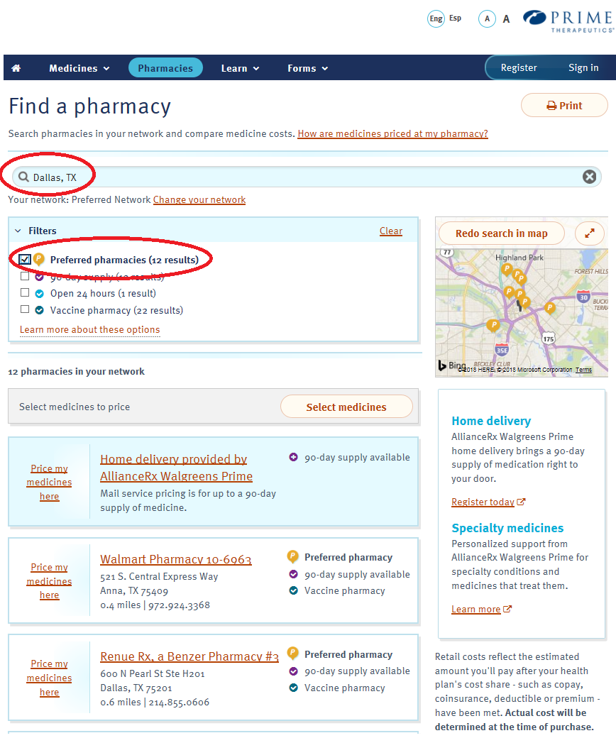
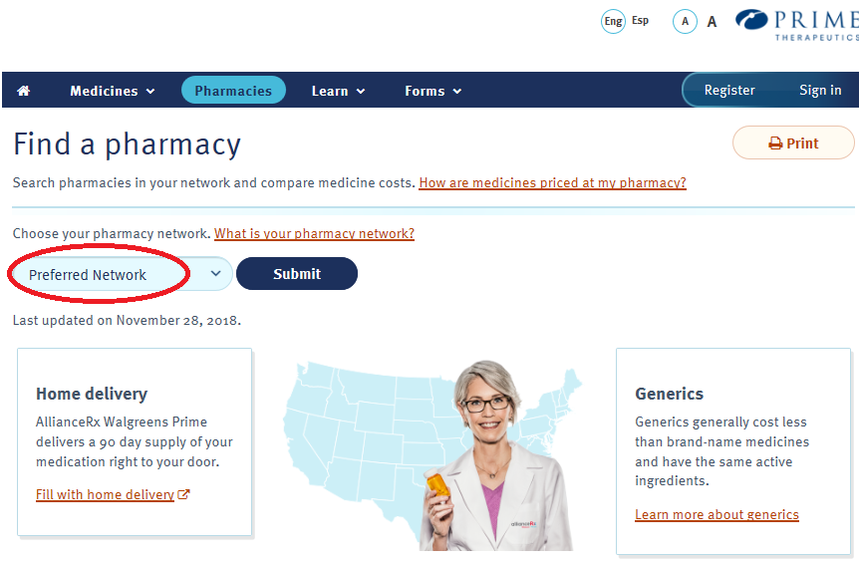
Finding a Preferred Pharmacy
Log on to www.myprime.com
Choose Pharmacy Network
Search by ZIP Code or City
Filter by Preferred Pharmacies

Slide 29
Home Delivery Prescriptions
Your pharmacy benefit includes mail service of your maintenance medications from AllianceRx Walgreens Prime
Register online at alliancerxwp.com/home-delivery or call 877-357-7463
Once registered, ask your doctor to submit your prescription electronically or by fax
Transfer your existing prescription from a retail pharmacy online or by phone
Prime Therapeutics has an ownership interest in AllianceRx Walgreens Prime, a central specialty and home delivery pharmacy.

Slide 30
Step Therapy
This program requires a “step” approach before you may receive coverage for certain high-cost medicines
You may need to use a safe, cost-effective, first-line drug before your benefit plan may cover another less preferred, second-line medicine included in the step therapy program.
If you and your doctor determine no alternate drug (including any available generic equivalent) is right for you, your doctor may submit a prior authorization request for coverage consideration of your current medicine.
Remember: Treatment decisions are always between you and your doctor, and cost is only one factor. Only you and your doctor can decide which medicine is right for you.
Notes:
Step Therapy is one of the Utilization Management programs.
These programs promote safe and proper use of medicines.
Please note: Select drugs that are new to the market may also need prior authorization. (See below.)
Step Therapy (ST) – If your drug is part of the ST program, you may need to use a preferred drug first before coverage can be approved for another drug. If you and your doctor decide that the preferred drug (including any available generic equivalent) is not right for you, your doctor can submit a prior authorization request to BCBSTX.
Members who are now taking a drug included in the program may not be affected.
Call the number on the back of your ID card for questions about a certain drug.
Prior Authorization (PA) – If your drug is part of the PA program, you will need to have your doctor submit pre-approval (also known as a prior authorization request) to BCBSTX.
If your request is approved, you will pay for your share of the drug, based on your benefit plan.
If your request is not approved, the drug will not be covered. You may still fill the prescription, but you may have to pay for the full amount charged by the pharmacy.

Slide 31
Blue Access for MembersSM
Save time with self-service support tools and health and wellness resources available through a convenient and secure website
Check claims and claims history
View, save or print Explanation of Benefits (EOBs)
Sign up for electronic EOBs, and save paper
View benefits and covered dependents
Check coverage details and Rx benefit information
Manage mobile and texting preferences
Request new ID cards or print temporary ID cards
Access health and wellness information and guides
Get details on wellness, discounts, 24/7 Nurseline
… and more
Log and perform protected transactions 24 hours a day, 7 days a week*
*Claim Statements/EOBs are not available from 3 – 6 a.m.
Notes:
Blue Access for Members
You can save time using self-service support tools, including the following and more:
Check the status of a claim; view and print Explanation of Benefits (EOBs)
Request new ID cards; print temporary ID cards
Confirm who is covered under the plan
Check plan coverage details and Rx benefit information
Secure access – employers can log in to their accounts and perform protected transactions 24 Hours a day, 7 days a week* [*Claim Statements/EOB’s are not available from 3-6 a.m.]
NOTE:
Blue Access for Members is available to all members. Options available within the portal will vary depending on group membership and benefit selections.

Slide 32
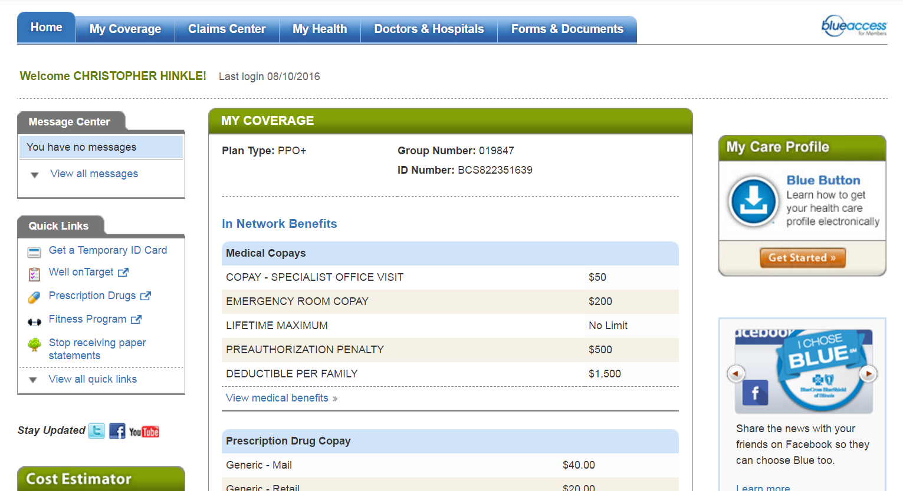
Navigating Blue Access for MembersSM
1
2
3
4
5
MEMBER NAME
Last login 08/01/2019
7
ABC123456789
6
1
My Coverage: Review benefit details for you and your covered dependents
Claims Center: View and organize details such as payments, claims status and more
My Health: Make more informed health care decisions by reading about health and wellness topics and specific conditions
Doctors & Hospitals: Use Provider Finder® to locate a network doctor, hospital or other health care provider
Forms & Documents: Use the form finder to get medical, dental, pharmacy and other forms quickly and easily
Quick Links: For easy access to member discounts, benefit programs and more
My Care Profile: Access and download a summary of provider visits, medications and test results
2
3
4
5
6
7
Screen images are for illustrative purposes only.
Notes:
More tools and resources to help you better understand and make the most of your health benefits
Learn about your plan coverage, order replacement ID cards, view and manage claims and much more
Research your options for care; Find and organize claims

Slide 33
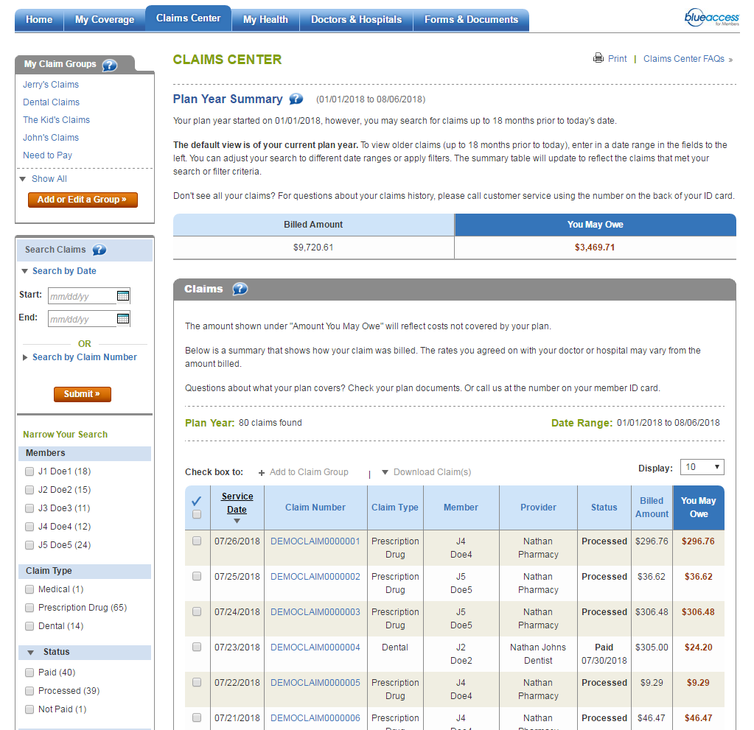
Claims Center
My Claim Groups to categorize and manage claims according to needs
Search Claims allows members to search by date ranges or claim numbers or filter the view based on dynamic categories
Claims Summary includes Medical, Rx and Dental all in one place
Screen images are for illustrative purposes only.

Slide 34
My Health Tab
Check out the My Health tab for access to hundreds of articles, health information links to videos and more helpful resources
Review your My Care Profile, find out more about Well onTarget®, the 24/7 Nurseline, the Fitness program and more
The Fitness Program is provided by Tivity Health, an independent contractor which administers the Prime Network of fitness centers. The Prime Network is made up of independently-owned and managed fitness centers.

Slide 35
Interactive Video Tutorials
Easy to use, technology-powered video coaching modules that enable the most informed treatment decisions
Select a topic from the list at left to view available videos.
Topics include:
Coronary artery disease
Bariatric surgery
Chronic low back pain
Depression
Diabetes
Blood sugar
Insulin injections
Type 2 diabetes
Metabolic syndrome
Screen images are for illustrative purposes only

Slide 36
Well onTarget® can provide you personalized action plans, lets you sync your fitness device, join self-management programs and more.
24/7 Nurseline conveniently answers your health questions.
Fitness Program gives you access to a network of gyms that fit your budget and lifestyle.
Women’s and Family Health provides support for cycle tracking, pregnancy and parenting.
Digital Health Partners help you manage metabolic syndrome, diabetes and high blood pressure through digital coaching programs.
Your Health and Wellbeing Programs
TO HELP YOU FIT BETTER HEALTH INTO YOUR SCHEDULE
Log in at bcbstx.com
Click the My Health tab
Notes:
Your new health benefits include tools that can help you get healthier how and when it works for you.
Through Blue Access for Members‭‭, you can access ‭resources to help you manage your health conditions, get ‭answers to health questions and reach your wellness goals.
For quick access to all your health and wellness resources:
Go to bcbstx.com.
Sign up for or log in to Blue Access for MembersSM.
Click the My Health tab to access all your health and wellness resources.
‭========================
Well onTarget is a voluntary wellness program. Completion of the Health Assessment is not required for participation in the program.‭
Blue Points‭ Program Rules are subject to change without prior notice. See the Program Rules on the Well onTarget Member Wellness Portal at wellontarget.com for further information. Member agrees to comply with all applicable federal, state and local laws, including making all disclosures and paying all taxes with respect to their receipt of any reward.‭
A $25 enrollment fee and $25 monthly fee apply per member (subject to change). Taxes may apply. Individuals must be at least 18 years old to purchase a membership.
‭24/7 Nurseline is not available to IL HMO members. For medical emergencies, call 911. This program is not a substitute for a doctor’s care. Talk to your doctor about any health questions or concerns.

Slide 37
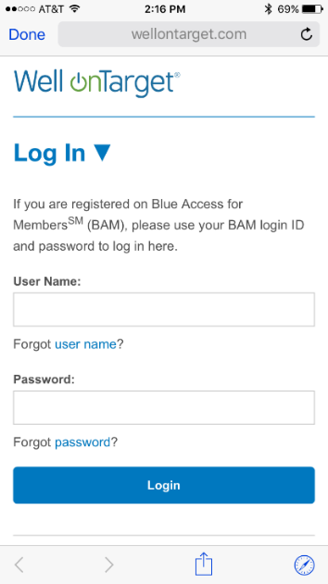
Member Wellness Portal
Well onTarget® Highlights
Health Assessment
Member dashboard
Digital self-management programs
Trackers and tools
Interactive symptom checker
Health and wellness content
Text message alerts
Fitness Program
Tracking for fitness and nutrition and also device integration
Personal wellness challenges
Mobile app (AlwaysOn)
The newly designed portal includes recommended activities that make up your Personal Member Journey.
Screen images are for illustrative purposes only.
The Fitness Program is provided by Tivity Health™ Services, LLC, an independent contractor which administers the Prime® Network of fitness centers. The Prime Network is made up of independently-owned and managed fitness centers. Prime is a registered trademark of Tivity Health, Inc. Tivity Health is a trademark of Tivity Health, Inc. Blue Cross®, Blue Shield® and the Cross and Shield Symbols are registered service marks of the Blue Cross and Blue Shield Association, an association of independent Blue Cross and Blue Shield Plans.

Slide 38
Blue365® Member Discount Program
Member discounts simply for being a BCBSTX member
Exclusive health and wellness deals from national and local retailers
Save money on gym memberships, vision exams and services, hearing aids, fitness devices and nutrition-related services
Log in to Blue Access for MembersSM and click “Member Discount Program” in Quick Links to view your available discounts and to register for weekly emails
Blue365 is a discount program only for BCBSTX members. This is NOT insurance. Some of the services offered through this program may be covered under your health plan. Employees should check their benefit booklet or call the Customer Service number on the back of their ID card for specific benefit facts. Use of Blue365 does not change monthly payments, nor do costs of the services or products count toward any maximums and/or plan deductibles. Discounts are only given through vendors that take part in this program and are subject to change. BCBSTX does not guarantee or make any claims or recommendations about the program’s services or products. Members should consult their doctor before using these services and products. BCBSTX reserves the right to stop or change this program at any time without notice.
Notes:
Blue365 member discount program. Simply for being a Blue Cross and Blue Shield of Texas member, you will be able to receive exclusive health and wellness deals from national and local retailers to help keep you healthy. Save money on health care products and services that are not always covered by your benefit plan such as gym memberships, vision exams and services, hearing aids, fitness devices and diet-related services.

Slide 39
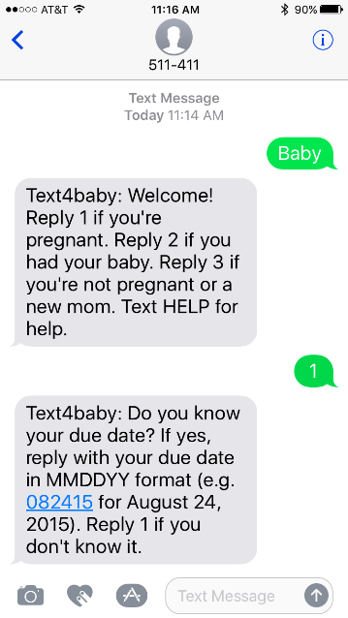
Special Beginnings®
Provide information about having a healthy pregnancy and baby
Share information about high-risk conditions, such as gestational diabetes and preeclampsia
Help you plan your care with your doctor
Option to receive text messages on baby development
Expectant mothers and babies get off to a healthy start with prenatal and postnatal education and support
Special Beginnings is not a substitute for professional medical guidance. Regular visits are important for your care. With your consent, the information we receive from you is shared with your physician to coordinate your care. Be sure to discuss any health concerns with your physician.
Notes:
The Special Beginnings maternity program provides information and education from early pregnancy until 6 weeks after delivery.
An experienced Blue Cross and Blue Shield of Texas registered nurse contacts you and may:
Ask questions to determine what support you’ll need
Send information about having a healthy pregnancy and baby
Help you plan your care with your doctor
Share information about high-risk conditions, such as gestational diabetes and preeclampsia
The Special Beginnings website has a video library and week-by-week pregnancy information. Log in to Blue Access for Members and look under My Health.

Slide 40
Dependent Children under 19
Pediatric Dental & Vision benefits are included as part of the Medical Plan in addition to the BCBS Dental plan and the Vision plan through VSPnumber on dental ID card
For information on Pediatric Vision – please call Davis-Vision at 800/350-1534
Refer to BCBC Medical Booklet for Specific Details

Slide 41
Your Dental Plan (BCBS TX) Policy #299985
Annual Limit - $1,500
Calendar Year Deductible $50 individual (3x family)
Preventative 100% - deductible waived
Basic 80%
Major 50%
Lifetime Limit - Orthodontia - $1,500
Dependent Child to Age 19
Adults (Employee or Spouse)

Slide 42
Features of your dental plan
Preventive cleanings 100% no deductible
(two every 12 months)
Full Mouth X-rays once every 60 months
Fluoride to Age 19 (two every 12 months)
Sealants to age 16 (one per unrestored permanent molar)
Space Maintainers to age 19
(one appliance per missing tooth)

Slide 43
Your Vision Benefits Group #30069274
Vision Service Plan - Call 800/877-7195
Choice of Providers -- Choose a VSP doctor, a participating retail chain, or any out-of-network provider
The largest network of independent eye doctors - VSP vision insurance is accepted by more than 34,000 doctors nationwide
Tell the provider you have VSP – NO ID Cards is necessary – You can print one at vsp.com
No claim forms to complete when you see a VSP network provider

Slide 44
Your Network Vision Benefits
Frequency of Vision Benefits
Exam – Every 12 Months
Lenses – Every 12 Months
Frames – Every 24 Month
Routine Eye Exam - $20 Copay
Contacts exam - up to $60 copay (plus exam copay)
Materials - $20 Copay Glasses or Contacts

Slide 45
Your Network Vision Benefits
Frame Allowance - $250
Featured Frame Allowance - $270
Contact Allowance - $250
Minor Eye Medical Condition - $20 Copay
Routine Retina Screening – Up to a $39 Copay
20% Discount on amounts over allowance or extra pair of glasses within 12 months of exam

Slide 46
Special Offers through VSP
Select from Extensive List of Featured Brands & receive ADDITIONAL $20 Allowance for Featured Frames
Rebates for contact lens, coupons, & other discounts

Slide 47
Register with VSP
24/7 access to your VISION claims and account information
www.vsp.com

Slide 48
Your Survivor & Disability Benefits
Reliance Standard Life (RSL)
Basic Life/AD&D - $50,000
Long Term Disability – 60% of salary to $6,000/month after 90 days of disability
Paid for by JBI, Ltd.
Option to Purchase Additional Term Life/AD&D Insurance

Slide 49
Option to Purchase Voluntary Term Life/AD&D Insurance
Available through Reliance Standard Life (RSL)
Choices of life insurance, for Employee and/or Spouse in increments of $10,000 to $500,000
Rate based on Age as of Sept. 1st
(adjusts once per year)

Slide 50
Option to Purchase Voluntary Term Life/AD&D Insurance
Spouse coverage based on Spouse Age (not EE Age)
Portability Included (at different rates)
Paid by Employee – After Tax Dollars
Child Life Only coverage $10,000
$1.62 per month or $.75 bi-weekly

Slide 51
Reliance Standard Life
Employee under age 60 - $100,000
(60-70 $10,000)
Spouse under age 60- $50,000
Voluntary Term Life Guarantee Issue available if Enrollment occurs when 1st Eligible
Notes:
SPECIAL **** Guarantee Issue - $50K EE to age 60; $10K Sp to age 60; $10K EE 60-70 if not previously declined or exhausted guarantee issue

Slide 52
You Can Pay Health Insurance Premiums with Pre-Tax Dollars through Section 125 – Significant Savings

Slide 53
Section 125 Components
1. Health Plan Premiums
2. Pre-Tax Out of Pocket Health Expenses
- Health FSA
3. Pre-Tax Dependent Day Care Expenses
- Dependent Care FSA

Slide 54
What is the cost for Health Insurance? Identify your tax bracket to determine Pre-Tax savings
Determine your Federal Income Tax (FIT) Bracket plus 7.65% FICA Taxes to calculate your Pre-Tax Savings

Slide 55
Do you know how much you pay in Taxes?
FICA – 7.65%
PLUS
Your Federal Income
Tax Rate
2018 Tax reform tax brackets
10%, 12%, 22%, 24%, 32%, 35%, & 37%
Depending on where you live…
You may also pay State & Local Taxes

Slide 56
What is your Federal Income Tax (FIT) Tax Bracket
2022 Tax Brackets and Rates
Rate | For Single Individuals, Taxable Income Over | For Married Individuals Filing Joint Returns, Taxable Income Over | For Heads of Households, Taxable Income Over
10% | $0 | $0 | $0
12% | $10,275 | $20,550 | $14,650
22% | $41,775 | $83,550 | $55,900
24% | $89,075 | $178,150 | $89,050
32% | $170,050 | $340,100 | $170,050
35% | $215,950 | $431,900 | $215,950
37% | $539,900 | $647,850 | $539,900
Source: Internal Revenue Service
Federal Income Tax (FIT) Bracket plus 7.65% FICA Taxes equals your Pre-Tax Savings
12% Bracket = .1965 22% Bracket = .2965 24% Bracket = .3165 32% Bracket = .3965
The standard deduction in 2022 is $12,950 single, $25,900 married/filing joint, $19,400 head of household
This is not tax advice. This material has been prepared for informational purposes only, and is not intended to provide tax advice. You should consult your own tax, legal, and accounting advisors for advice.

Slide 57
How much do you have to earn in the 22% Tax Bracket to take home $300?
22% Tax Bracket
Gross Earnings $ 426.44
FICA (7.65%) -$ 32.62
FIT -$ 93.82
Net Earnings $300.00
$126.44 in Taxes
Paying for Health Insurance Premiums with
Pre-Tax results in Substantial Savings
Notes:
If in the 12% tax bracket, $73.36 in Taxes
Gross Earnings $373.37 for $300 net

Slide 58
How much do you have to earn in the 24% Tax Bracket to take home $300?
24% Tax Bracket
Gross Earnings $ 438.92
FICA (7.65%) -$ 33.58
FIT -$105.34
Net Earnings $300.00
$138.92 in Taxes
Paying for Health Insurance Premiums with
Pre-Tax results in Substantial Savings

Slide 59
How much do you have to earn in the 32% Tax Bracket to take home $300?
32% Tax Bracket
Gross Earnings $ 497.10
FICA (7.65%) -$ 38.03
FIT -$ 159.07
Net Earnings $300.00
$197.10 in Taxes
Paying for Health Insurance Premiums with
Pre-Tax results in Substantial Savings

Slide 60
IRS Rules
All Elections are made Prospectively
No changes unless Life Changing Event
Use it or Loose It
Health FSA changes only at new Plan Year (January 1st of each year)

Slide 61
What is a Life Changing Event?
Your Marriage or Your Divorce
Birth or Adoption of Your Child
Death / Termination of your dependent relationship
Change of Job/Job Status by You or Your Spouse
Other situations as determined by IRS

Slide 62
I already pay my health premiums with pre-tax dollars … What else can I do to lower my taxes?

Slide 63
Consider Setting up Flexible Spending Accounts (Plan Year = Calendar Year)
Health FSA
Maximum $2,850 per year (Cal. Year 2022)
Dependent Care FSA
Maximum $5,000 per year

Slide 64
Plan Year - Flexible Spending Accounts
Calendar Year - January 1st to December 31st
Plus a 2 ½ month grace period
Equals
14 ½ months to Incur eligible Claims

Slide 65
What is Health Flexible Spending Account?
A Pre-Tax Health Spending Account
Spending Account to pay for out of pocket medical, dental, & vision expenses (not covered by ANY insurance)
Health FSA is for You & Your dependents, even if not covered under medical plan
Funds are available 1st day of the plan year if you incur an eligible expense & file a claim

Slide 66
Health FSA Examples IRS Section 213
Prescription Copays
Office Visit Copays
Deductible
Coinsurance (Your Portion)
Vision
Orthodontia
Over the Counter medications (added under Cares Act 2020)
Menstrual products (added under Cares Act 2020)
Some items it excludes are: pre-payment of services, supplements, health club dues, and cosmetic services
Notes:
OTC & Menstrual added 1/1/2020 under Care Act – - OTC does not require a Prescription under Cares Act & is retro to 1/1/2020; stockpiling (3 or more of any one item) is not allowed

Slide 67
You cannot claim the tax deduction for medical expenses and Health FSA
Medical Expenses must exceed
7.5%
of income to be eligible for a tax credit
Notes:
Permanent Reset the deduction to 7.5% for 2021 & later

Slide 68
What is Dependent Care FSA?
A Pre-Tax Dependent Day Care Account
Reimburses for daycare costs for your child (up to age 13 years) or a disabled adult you are legally responsible
Eligible if You & Your spouse (if married) are working or are full-time students
You must incur & file an eligible claim -
Funds are available ONLY once deposited in the account

Slide 69
You Cannot claim both the tax credit & use Dependent Care FSA Which is better in your situation?

Slide 70
Tax Credit versus Dependent Care FSA
Tax Credit
$3,000 per child (max. 2 children)
Tax Credit % - 20% to 35% depending on salary
Dependent Care FSA
$5,000 maximum limit
Tax Savings = Federal Tax Bracket + 7.65% FICA

Slide 71
What is better for me? (Tax Credit versus Dependent Care FSA)
Depends on your income, number of children, & child care costs
Complete the Flex Worksheet within the FSA Enrollment/Worksheet
You may choose Dependent Care FSA OR take a year-end tax deduction – (but not both)

Slide 72
How do I obtain Reimbursement?
Incur an Eligible Expense during the Plan Year AND File a Claim with our FSA Administrator UHC

Slide 73
FSA Administrator
UnitedHealthcare (UHC)
www.uhcservices.com
Participant Call Center 877/797-7475
Register with UnitedHealthcare 24/7 access to your FSA claims and account information www.uhcservices.com

Slide 74
Your Supplemental Insurance Benefits
Cancer
Accident
Medical Bridge
Critical Illness
Notes:
Colonial Life – Supplemental benefits

Slide 75
Colonial Life Supplemental Insurance
Benefits are Portable Even if you Terminate
At Issue Age
Colonial pays you directly…
in addition to health insurance
Notes:
Individual Policies
Enrollment in Medical Plan not required

Slide 76
Colonial Life Supplemental Insurance
Colonial pays you directly, in addition to health insurance
30 day waiting period for Cancer, Critical Illness, & Wellness/Health Screenings
Colonial benefits are at the Issue Age if you terminate & wish to continue coverage
Guaranteed Renewable
Notes:
Pays IN ADDITION to health plan
Issue Age
Individual Policies – can be customized

Slide 77
Colonial Life Supplemental Insurance
Supplemental Policies are Individual Policies
Minimal Underwriting
Duplication of Colonial Policies Not Permissible
Colonial does not Coordinate with your Medical Insurance policy
Notes:
Cannot Duplicate Colonial policies
No Coordination with Medical policy

Slide 78
Accident, Medical Bridge, & Cancer are Paid with Pre-Tax $ Review the Cost Example in your Tax Bracket
Examples available for 22%, 12%, 24%, & 32% Tax Bracket – see Colonial Packet or Benefit Website for examples
Examples found under Supplemental Summaries of Health Benefit Resources at
www.thediamondbenefitgroup.com/jbi-ltd/
Notes:
Examples on Website
Various Tax Brackets

Slide 79
Accidents can happen ANY TIME
Accidents can happen anywhere …
Broken bones
Sports-related accidental injury
Burn
Back or knee injuries
Concussion
Laceration
Car accidents
Falls & spills
Dislocation

Slide 80
Accident Policy
Pays for Doctor Visits, ER, Urgent Care, X-ray, Hospital Admission, Accidental Death & more
$50 Health Screening after 30 day waiting period
Premiums Paid with Pre-Tax Dollars
Includes Children in Sports
Pays $125 for Initial Accident plus amount of Scheduled Benefit
Notes:
$125 Initial – 3 Followups @$50
If app in Tx – Use Tx policy
GA & CT – No wellness; Illinois, Ohio, South Carolina very comparable
PA has higher rates but slightly higher benefits
Florida has lower rates but higher benefits
Indiana, Kentucky, & New York have comparable rates but higher benefits
Accidental Death: TX, IL, OH, PA, SC, TN, CT, & NJ = $25K GA & NY & FL = $40K KY = $50K IN = $75K

Slide 81
ACCIDENT EXAMPLES OF ELIGIBLE BENEFITS Refer to Outline of Coverage for Complete List of Scheduled Benefits
Ambulance $200 ($2,000 for Air)
Ruptured Disc $500
Medical Imaging $150
Prosthetics $500 to $1,000
Tendon/Ligament/Rotator Cuff $500 to $1,000
Knee Dislocation $1,100 to $2,200
Burn $1,000 to $12,000
Coma $10,000
Eye Injury $300
Appliance $100
Hip Fracture $1,650 to $3,300
Knee Cartilage Torn $500
Laceration $30 to $500
Hernia $150 to $1,500
Xray $30
Accidental Dismemberment $750 to $15,000
Concussion $60
Toe Fracture $220 - $440
Notes:
TX Limits
Concussion - $60; Ambulance $200 (air $2,000); PT $25 for 10 days; Prosthetics - $500 to $1,000
Transportation $500/trip (3 rounds); Medical Imaging $150/once CY
Hospital admission $1,000 ($225/day up to 365 days); ICU $2,000 ($450/dayup to 15 days)

Slide 82
Accident Health Screening
$50 Health Screening benefit per year
per person after 30 day waiting period
Some Examples of Eligible health screening for Accident policy
Blood test for Triglycerides
Serum Cholesterol Test for HDL/LDL Levels
Mammogram
Fasting Blood Glucose Test
Pap Smear
Blood Test for Colon Cancer
Stress test on bike/treadmill
PSA
See outline of Coverage for complete list of eligible health screenings in Accident policy

Slide 83
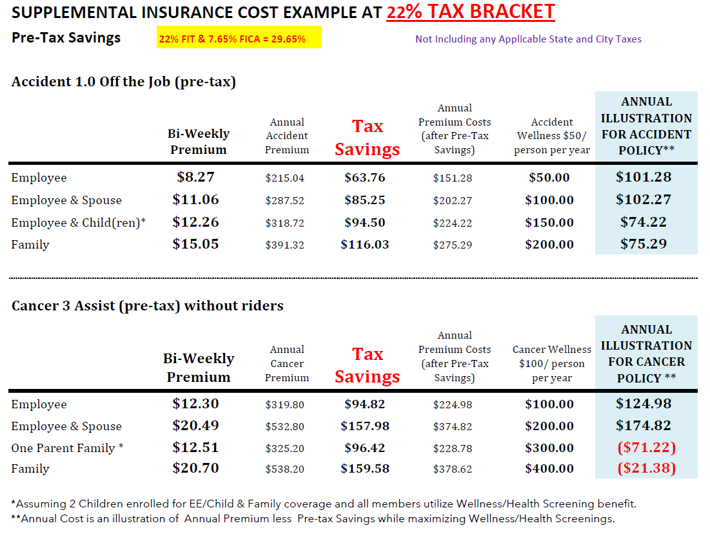

Slide 84
Diagnosed with Cancer
Review Cancer Outline of Coverage
Help when you need it most --
Some examples include
Hospital Confinement
Ambulance
Nursing Services
Radiation/Chemotherapy
Experimental Treatment
Transportation/Lodging
Surgical Procedures
If cancer impacts your life, you should be able to focus on getting better – not on how to pay your bills
Benefits are paid directly to YOU

Slide 85
CANCER POLICY
See Outline for Scheduled Benefits
No lifetime limits
$100 Cancer screening/wellness per covered person
30 day waiting period
Optional Riders available
Specified Disease
Initial Diagnosis
Progressive Payment
Pays you if diagnosed with Cancer –
Affordable premiums paid with pre-tax dollars

Slide 86
Cancer Supplemental Policies
Review Cancer Outline of Coverage
Cancer Assist – Policies enrolled since 9/2016
Cancer 1000 – Policies written before 9/2016
Existing Cancer 1000 participants automatically remain under current Cancer 1000 policy - If participant requests to replace Cancer 1000 with Cancer Assist, 30 day waiting period waived with policy transfer if approved

Slide 87
Cancer Wellness
30 day waiting period
Colonoscopy & Virtual colonoscopy
Mammography
Pap Smear & ThinPrep pap test
PSA (blood test for prostate cancer)
Serum Protein Electrophoresis (blood test for Myeloma)
CA 15-3 (blood test for breast cancer)
CA125 (blood test for ovarian cancer)
CEA (blood test for colon cancer)
Flexible sigmoidoscopy
Hemoccult stool analysis
Thermography
Chest x-ray
Bone Marrow Aspiration/Biopsy
Biopsy of Skin Lesion
Breast Ultrasound
CancerAssist policies include $100 reimbursement for Health Screening tests: Blood test for Triglycerides, Carotid Doppler, ECHO, EKG, ECG, Fasting Blood Glucose, Serum Cholesterol for HDL/LDT, Stress test on bicycle/treadmill
PART 1 – Wellness Pays $100 per person per calendar year
PART II – Pays you $100 for additional invasive diagnostic procedure (as a result of an abnormal cancer screening test)

Slide 88
Medical Bridge (Hospital Income)
Medical Bridge IMB7000 Available for New Participants
IMB 7000
Hospital inpatient –
Choice of $1,000 or $2,000 hospital admission
Outpatient Surgery - $750 Tier 1; $1,500 Tier 2
CYM outpatient $2,500
$50 wellness per covered person/per calendar year –
Please refer to Outline of Coverage for tests eligible under wellness benefit

Slide 89
Medical Bridge (Hospital Indemnity)
Pays you lump sum for hospital confinement or outpatient surgery
$50 wellness per person after 30 days
Rates are Age Banded (premiums paid with pre-tax dollars)
17-49 50-59 60-64 65-74
Covers pregnancy (policy must be in force for 10 mos.)
Pre-Existing limitation – generally for first 12 Months
Same accident/sickness within 90 days – continuation of previous confinement

Slide 90
Medical Bridge Supplemental Policies
IMB7000 –MB Policies since 9/1/2019
MB3000 DB & DD – Policies enrolled 9/2017 to 8/2019
MB3000 BB & BD – Policies written before 9/2017
Participants who were enrolled in Medical Bridge3000 plans (BB, BD, DB, & DD) prior to September 1, 2019 will be grandfathered but are eligible to apply for a transfer to the IMB7000 Medical Bridge at existing age at time of application. If new policy is approved, policy will be transferred. Medical Bridge 3000 wellness benefits limited to 2 per family.
Notes:
Considerations to Change:
Age Bracket Changes
Outpatient Benefit (New is higher than phase 1 but lower than phase 2)
Wellness is $50 per person (if family covering 3+ members – new is better plan)

Slide 91
Critical Illness
Pays 100% of Lump Sum Benefit you Select
Heart Attack
Stroke
Major Organ failure
End State Renal - Kidney failure
Coma
Blindness
Permanent Paralysis due to Covered Accident
Occupational effectious HIV or Hepatitis B, C, D
Pays 25% for Coronary Artery Bypass Graft Surgery
Review Critical Illness Outline of Coverage

Slide 92
Critical Illness
Premiums are based on Your Age, Tobacco Status, & Amount of Coverage
Initial 30 Day Waiting Period
Pre-existing limitation generally for12 months
Maximum benefit amount is reduced by 50% on anniversary date after age 75
Premiums paid with After Tax Dollars

Slide 93
Critical Illness
You select Lump Sum benefit between $5,000 to $75,000 in $1,000 increments; Includes Subsequent Diagnosis
Maximum Policy benefit is Three (3X) Initial Lump Sum
Family coverage includes Spouse at 50% and children at 25% of name insured
No additional premium to add Children but they are eligible for health screening
$50 health screening per person/year after 30 day waiting period

Slide 94
Critical Illness Health Screening
$50 Health Screening benefit per year
per person after 30 day waiting period
Few Examples of Eligible health screening for Critical Illness Policy
Blood test for Triglycerides
Serum Cholesterol Test for HDL/LDL Levels
Mammogram
Pap Smear
Fasting Blood Glucose Test
Blood Test for Colon Cancer (CEA)
PSA
Please refer to Outline of Coverage for Complete List of Health Screenings

Slide 95
Critical Illness Cost Example for Non-Smoker
Age 31, Lump Sum $7,000 Employee coverage for Critical Illness
Cost per Pay Period $2.25 (after-tax)
Annual Premium $58.56
Health Screening Reimbursement $50
Net Annual Cost - $8.56 ($58.56 minus $50)

Slide 96
Critical Illness Cost Example for Non-Smoker
Minimal differences due to rounding may apply
Age 42, Lump Sum $5,000 Employee and $2,500 Spouse coverage for Critical Illness
Cost per Pay Period $4.32 (after-tax)
Annual Premium $112.20
Health Screening Reimbursement $100 ($50 each)
Net Annual Cost - $12.20 ($112.20 minus $100)

Slide 97
Register with Colonial Life for 24/7 access to your Supplemental insurance claims and account information
www.coloniallife.com/register
Select policyholder website
Customer Service (800) 325-4368

Slide 98
Questions ?
Human Resources Manager, Bob Kimbrell
Health Benefits Consultant, Debbie Fleck

